Slide 1
Citrix Reference Architecture on Microsoft Azure
Loay Shbeilat
Senior Solution Architect
7/14/2015

Slide 2
Why Azure
Azure Concepts
Architectural discussion
Building the environment
Economics
Agenda
Notes:
Understand architectural considerations when building Citrix in Azure
Not a full deployment guide (mini deployment guide) and highlight some deployment essentials
Discuss scale and economics
Prasanna will discuss futures….

Slide 3
You can build XenApp/XenDesktop 7.6 in Azure today
Apps, Sessions and server VDI are available

Slide 4
Demo
My virtual desktop in Azure

Slide 5
Desktop & App Virtualization
On-premises
Cloud
Choice
Available today
Available preview
XD/XA
On-premises
XD/XA
On IaaS
XD/XA
Hosted
CWC
any infrastructure
Provisioning | Customer IT | Customer IT | Partner | Customer or Partner
Updates | Managed by IT | Managed by IT | Managed by Partner | Managed by Citrix
Model | Single Tenant | Single Tenant | Multi-Tenant | Single or Multi-Tenant
Licensing | Perpetual | Perpetual | Subscription (User/month) | Subscription (User/month)
Cloud | Private cloud | Public (Azure, AWS) | Partner Cloud | Private, Partner, Public (Azure), Government*
* Azure Government Cloud

Slide 6
Why Azure?

Slide 7
Microsoft will support you !!! Big Time !!

Slide 8
Why? Other reasons…
CAPEX vs OPEX
Disaster Recovery site
Geo-dispersed sites
Burst Capacity
Reduce time to ROI
Notes:
Cloudapp.net suffix

Slide 9
Terminology / Definitions - Summery

Slide 10

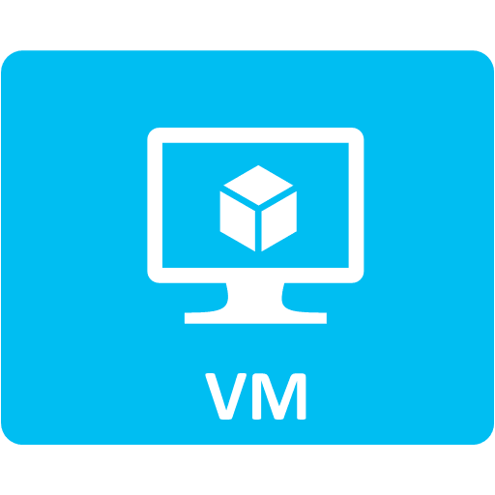
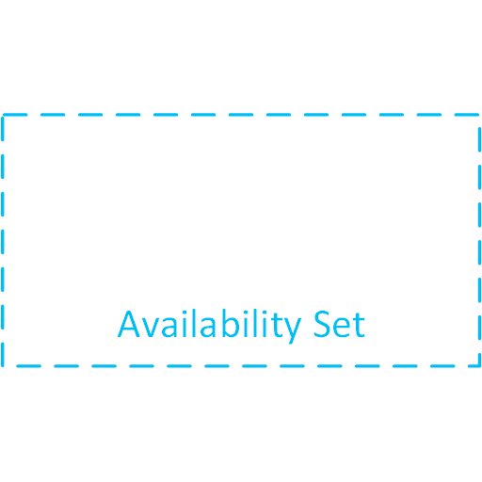

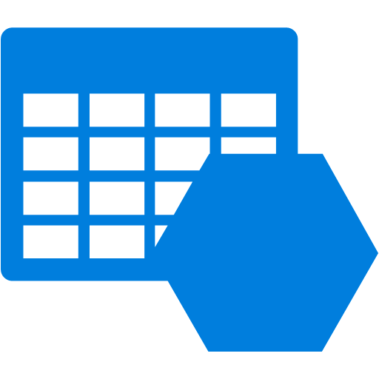
Azure building blocks
Cloud service
Container for virtual machines
Security boundary for endpoints and ACLs
Virtual machine
Availability set
Group of VMs within a datacenter that are located on different racks
Virtual Network
Storage account
Notes:
Cloudapp.net suffix

Slide 11
Azure infrastructure services hierarchy
VMs are hosted in a cloud service
VMs can be a member of an availability set
VMs can be located on subnets
Subnets are part of a virtual network
A virtual network is part of an affinity group
Subnet
Virtual Network
Affinity Group

Slide 12
Demo
Environment Walkthrough

Slide 13
Architecture
Notes:
Basic architecture (quick jumpstart topology)
Simple Azure only
Simple Hybrid
Extended architecture
Scale
Availability

Slide 14

Simple Citrix deployment on Azure
Delivery Controller
Storefront
XA Session Host
Netscaler Gateway
AD Controller
Connect Via cloudapp.net port 443 endpoint to Netscaler Gateway
Server VDI
License Server
SQL Server
Single Subnet
Virtual Network
Notes:
Connecting via port 443
All those roles can be installed on a single VM for your PoC
SQL express

Slide 15
Simple hybrid deployment
AD Controller
Delivery Controller
Storefront
XA Session Host
Site-to-Site VPN
Netscaler Gateway
AD Controller
Connect Via cloudapp.net port 443 endpoint to Netscaler Gateway
Server VDI
Company resources and Applications Data
License Server
SQL Server
Single Subnet
Virtual Network
On-Premise Network
Notes:
Connecting via port 443
All those roles can be installed on a single VM for your PoC
SQL express

Slide 16
How about we go beyond the PoC!
Scalable and highly available

Slide 17
Framework
XenApp on Azure Architecture
1
Get customer requirements
2
Understand performance benchmarks
3
Understand Azure limits

Slide 18
Framework
XenApp on Azure Architecture
1
Get customer requirements
2
Understand performance benchmarks
3
Understand Azure limits

Slide 19
Customer Requirements
Citrixonazure.com
Company Profile
1000 users workforce is evenly split between New York and California
800 are office workers and will require shared hosted desktops (400 per site)
200 are power users and will require a server VDI desktop (100 per site)
User’s Profile
Office Worker | Power User
10 IOPS | 100 IOPS
300 kbps | 500 kbps
Notes:
Understanding Citrix on Azure scale
IOPS requirement
Sessions per Azure instance type
Understanding Azure limits and constraints
Achieving high availability
Azure dependent availability
Built in Citrix availability

Slide 20
Framework
XenApp on Azure Architecture
1
Get customer requirements
2
Understand performance benchmarks
3
Understand Azure limits

Slide 21
Instance types evaluated by Citrix
Instance types | Virtual cores | RAM
A0 | Shared | 768 MB
A1 | 1 | 1.75 GB
A2 | 2 | 3.5 GB
A3 | 4 | 7 GB
A4 | 8 | 14 GB
A5 | 2 | 14 GB
A6 | 4 | 28 GB
A7 | 8 | 56 GB
Instance types | Virtual cores | RAM
D1 | 1 | 3.5 GB
D2 | 2 | 7 GB
D3 | 4 | 14 GB
D4 | 8 | 28 GB
D11 | 2 | 14 GB
D12 | 4 | 28 GB
D13 | 8 | 56 GB
D14 | 16 | 112GB
Notes:
Assessment was based on LoginVSI (for the XA servers)
Validated A0 thru A7 (session-based delivery)
Tested the light and medium workloads (loginVSI 4.0)
Validated D1 thru D14 (session-based delivery)
Tested the Task-worker, Office-worker and knowledge-worker workloads (loginVSI 4.1)

Slide 22
Scale numbers by Azure instance type
Notes:
Find the right fit VM… more expensive / more powerful doesn’t necessary get you better performance

Slide 23
Scale numbers by Azure instance type
* D instance type validation is still in progress and these are not final numbers

Slide 24
Summary of scale
For server sessions (XenApp)
Users per A3 instance 18 for medium workload
IOPS per A3 instance < 300 for medium workload
For server VDI
Most appropriate instance types A1
IOPS per second for single user on VM ~ 100 IOPS

Slide 25
Framework
XenApp on Azure Architecture
1
Get customer requirements
2
Understand performance benchmarks
3
Understand Azure limits

Slide 26
Azure limits and constraints
http://azure.microsoft.com/en-us/documentation/articles/azure-subscription-service-limits/
Virtual machines per cloud service 50
Max IOPS for disk (standard) 500
Max IOPS for disk (basic) 300
Max IOPS per storage account 20,000
Cloud services per subscription 200
Storage accounts per subscription 100

Slide 27
Framework
XenApp on Azure Architecture
1
Get customer requirements
2
Understand performance benchmarks
3
Understand Azure limits

Slide 28
Therefore, for a site, we need…
Infrastructure servers
NetScaler (2)
XenDesktop Controller (2)
XenApp session hosts
400 users / 18 users per server ~ 23 servers
Server VDI hosts
100 servers
Storefront (2)
License Server (1)
DC (1)
23 servers x 300 IOPS = 6900 IOPS
100 servers x 100 IOPS per server = 10000 IOPS
SQL Server (2)
1 Cloud Service
1 Storage Account
1 Load Balancer
1 Cloud Service
1 Storage Account
2 Cloud Services
1 Storage Account

Slide 29


Single Subnet
443
443
Netscaler
Storefront
Delivery Controller
SQL Server
AD Controller
Virtual Network
443
Netscaler
Storefront
Delivery Controller
SQL Server
License Server
XD VDI Host
XD VDI Host
XA Session Host
WestCitrix.CloudApp.net
(50 hosts)
(50 hosts)
(23 hosts)
Infrastructure Storage Account
VDI Storage Account
XA Storage Account
Citrix.trafficmanager.net CNAME: citrixonazure.com
Single Subnet
443
443
Netscaler
Storefront
Delivery Controller
SQL Server
AD Controller
Virtual Network
443
Netscaler
Storefront
Delivery Controller
SQL Server
License Server
XD VDI Host
XD VDI Host
XA Session Host
EastCitrix.CloudApp.net
(50 hosts)
(50 hosts)
(23 hosts)
Infrastructure Storage Account
VDI Storage Account
XA Storage Account
Notes:
Prasanna Asks:
Netscaler?
Licenses?

Slide 30
How do I do this?
Notes:
This will touch upon the main differences from your traditional on-premise deployments

Slide 31
Recipe for success
Configure your Azure topology.
Install XenDesktop infrastructure components.
Prepare and capture your golden image.
Create XenApp server VMs based on golden image.
Add XA VMs to Machine Catalog and create Delivery Group.
Install and configure Netscaler Gateway.
Configure Storefront.
Notes:
And prerequisits
For VDA

Slide 32
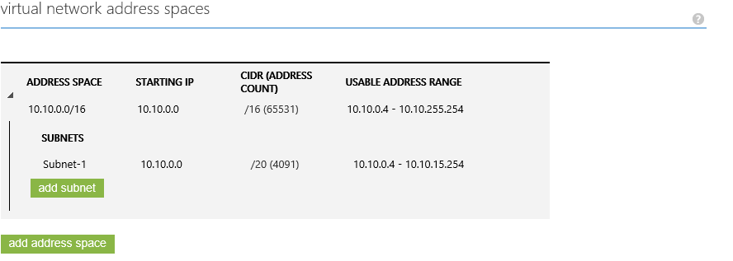
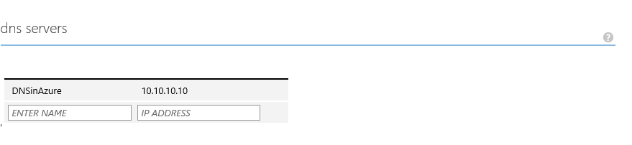
Configure your Azure topology
Create virtual network – virtual network address space
Create virtual network – DNS server

Slide 33
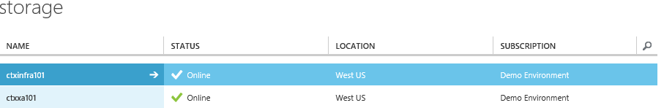
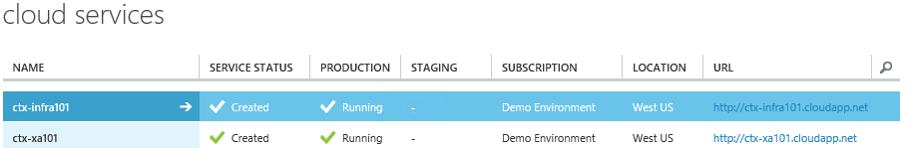
Configure your Azure topology (continued)
Create storage accounts
Create cloud services

Slide 34
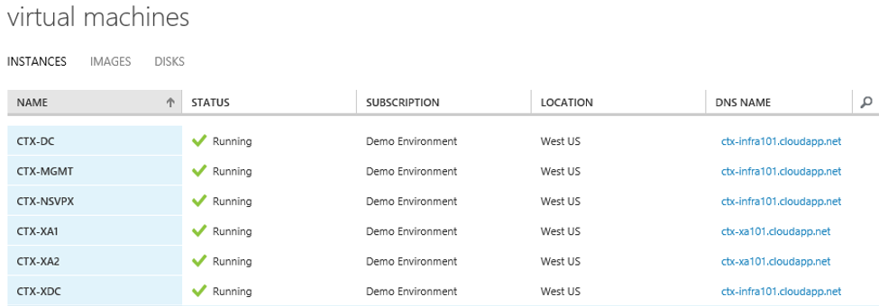
Configure your Azure topology (continued)
Create VMs – preferably set to static IPs

Slide 35
Provisioning script used to create infrastructure VMs
Add-AzureAccount
##Get-AzureSubscription | select SubscriptionName
$AzrSubName = “Subscription Name"
Select-AzureSubscription -SubscriptionName $AzrSubName
##Get-AzureStorageAccount | select StorageAccountName
$AzrStorName = “storage account name"
Set-AzureSubscription -SubscriptionName $AzrSubName -CurrentStorageAccountName $AzrStorName
##Get-AzureAffinityGroup | select Name,Location
$AzrAffinGrpName = “affinity group name"
##Get-AzureVNetSite | select name,Subnets
$AzrNetworkName = “network name"
$AzrSubnetName = “Subnet name"
## The VMName will also be used as the "Cloud Service" name
## Ensure the name is not already in use
##Test-AzureName -Service -Name $VMName
$VMName = “Server Name"
$VMUseStaticIP = $true
$VMIPv4 = “IP address"
$VMAdminName = “tempAdmin"
$VMAdminPass = ‘temp password'
##These only matter if you want a DOMAIN JOINED computer
$VMJoinDomain = $true
$VMDomainDNSName = “domain.com"
$VMDomainNETBIOS = “domain"
$VMDomainUserName = “domain user to join"
$VMDomainUserPass = ‘domain user password'

Slide 36
Provisioning script (continued)
##http://msdn.microsoft.com/library/windowsazure/dn197896.aspx
$VMSize = "ExtraLarge"
##[TimeZoneInfo]::GetSystemTimeZones() | select DisplayName,Id
$VMTimeZone = "Pacific Standard Time"
##$AzrImages = Get-AzureVMImage | where {$_.ImageFamily -like "*Windows Server 2012 R2*"}
##$AzrImages | select PublishedDate,Label,ImageName
##Copy the ImageName of the template you want to use
$ImageName = "a699494373c04fc0bc8f2bb1389d6106__Windows-Server-2012-R2-201407.01-en.us-127GB.vhd"
## Define the initial Configuration of the VM
$MyVM = New-AzureVMConfig –ImageName $ImageName –Name $VMName –InstanceSize $VMSize –HostCaching "ReadWrite" –DiskLabel "System"
## Configure VM to be Domain or WORKGROUP Joined
if ($VMJoinDomain) {
$MyVM = Add-AzureProvisioningConfig –VM $MyVM –WindowsDomain -AdminUsername $VMAdminName –Password $VMAdminPass -TimeZone $VMTimeZone -JoinDomain $VMDomainDNSName -Domain $VMDomainNETBIOS -DomainUserName $VMDomainUserName -DomainPassword $VMDomainUserPass
} else {
$MyVM = Add-AzureProvisioningConfig –VM $MyVM –Windows -AdminUsername $VMAdminName –Password $VMAdminPass -TimeZone $VMTimeZone
}
## Connect to the Subnet in the pre-existing Virtual Network
$MyVM = Set-AzureSubnet -SubnetNames $AzrSubnetName –VM $MyVM
## Configure the DHCP Reservation / Static IP if applicable
if ($VMUseStaticIP) {
$MyVM = Set-AzureStaticVNetIP –VM $MyVM -IPAddress $VMIPv4
}
## Create the Virtual Machine
New-AzureVM –VM $MyVM –ServiceName "XenAppSrvrsCS1" -AffinityGroup $AzrAffinGrpName -VNetName $AzrNetworkName

Slide 37
Recipe for success
Configure your Azure topology.
Install XenDesktop infrastructure components.
Prepare and capture your golden image.
Create XenApp server VMs based on golden image.
Add XA VMs to Machine Catalog and create Delivery Group.
Install and configure Netscaler Gateway.
Configure Storefront.
Notes:
And prerequisits
For VDA

Slide 38
Install software components
Domain controller : Windows 2012 R2
SQL server : SQL 2012 SP1
Desktop controller : XD7.6 on Windows 2012 R2
XenApp workers : XD7.6 VDA on Windows 2012 R2
Server VDI : XD7.6 VDA on Windows 2012 R2
Netscaler Gateway : 10.5.51.e

Slide 39
Recipe for success
Configure your Azure topology.
Install XenDesktop infrastructure components.
Prepare and capture your golden image.
Create XenApp server VMs based on golden image.
Add XA VMs to Machine Catalog and create Delivery Group.
Install and configure Netscaler Gateway.
Configure Storefront.

Slide 40
Prepare – XenApp worker server
Create server image
Create a new Windows Server 2012 R2 VM
Prep server golden image with all required software
Install the Citrix virtual delivery agent (VDA) via the user interface
Sysprep image
sysprep /generalize /oobe /shutdown

Slide 41
Prepare – Server VDI
Create server image
Create a new Windows Server 2012 R2 VM
Prep server golden image with all required software
Install Desktop Experience
Install Citrix VDA via command line
XenDesktopVdaSetup.exe /quiet /servervdi
Create string value ListofDDCs and point it at the appropriate DDCs under HKEY_LOCAL_MACHINE\SOFTWARE\Citrix\VirtualDesktopAgent
Sysprep image
sysprep /generalize /oobe /shutdown

Slide 42
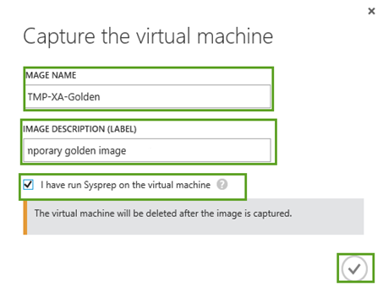
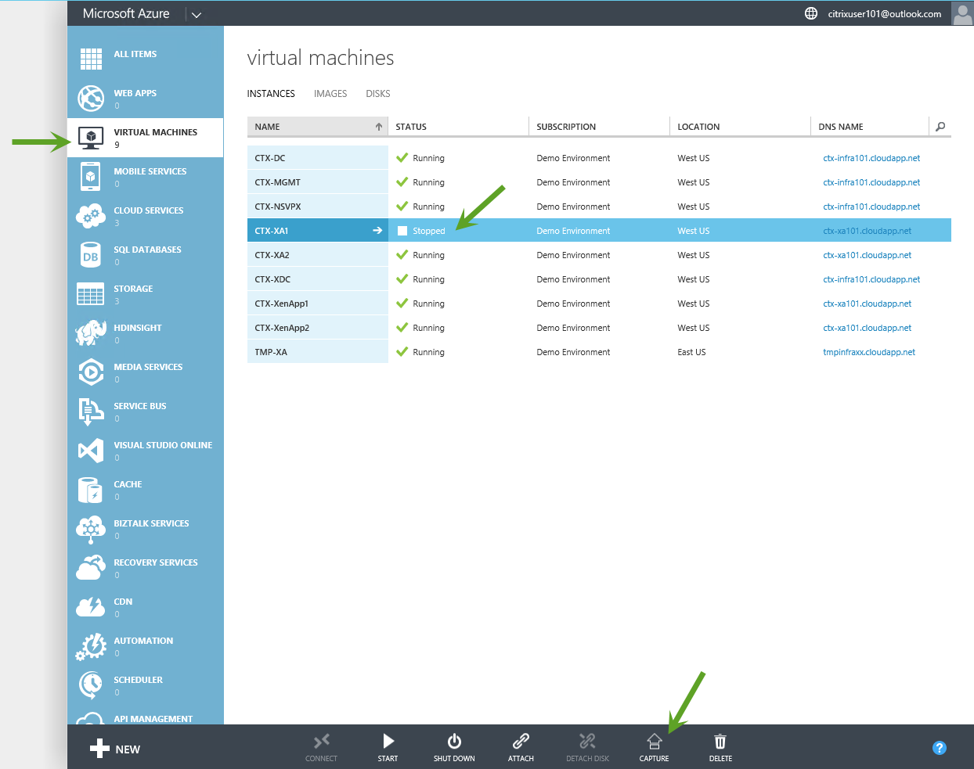
Capture Image in Azure

Slide 43
Recipe for success
Configure your Azure topology.
Install XenDesktop infrastructure components.
Prepare and capture your golden image.
Create XenApp server VMs based on golden image.
Add XA VMs to Machine Catalog and create Delivery Group.
Install and configure Netscaler Gateway.
Configure Storefront.

Slide 44
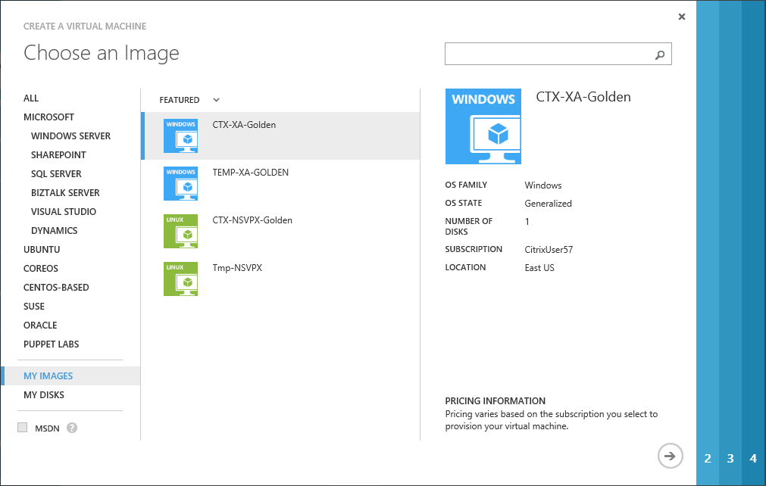
Clone Golden Image
Use Azure portal to manually create virtual machines based of golden image
Alternatively use the powershell script provided to create multiple VMs based of golden image

Slide 45
Provisioning input XML
<?xml version="1.0" encoding="utf-8"?>
<!-- Version 1.0.0 -->
<XACreate>
<Azure>
<!--File path of Azure publish setting file for authenticating into Microsoft Azure -->
<Variable Name="AzurePublishSettingFile" Value="C:\yourfile.publishsettings"/>
<!--Azure subscription name (case-sensitive) -->
<Variable Name="CurrentAzureSubscriptionName" Value=“Your Subscription"/>
<!--Cloud Service Name -->
<Variable Name="CloudServiceName" Value="CitrixInfraWest"/>
<!--Storage Account Name -->
<Variable Name="AzrStorName" Value="infrastoragewest"/>
<!--Affinity Group Name -->
<Variable Name="AzrAffinGrpName" Value="CitrixRegionWest"/>
<!--Virtual Network Name -->
<Variable Name="AzrNetworkName" Value="WestNetwork"/>
<!--Subnet Service Name -->
<Variable Name="AzrSubnetName" Value="Subnet-1"/>
</Azure>

Slide 46
Provisioning input XML (continued)
<VMconfig>
<!-- Number of XA servers to provision-->
<Variable Name="XAserversCount" Value="5"/>
<!--GoldenImagetoUse -->
<Variable Name="ImageName" Value=“TMP-XA-Goden"/>
<!--VM Base Name-->
<Variable Name="VMBaseName" Value="CTX-XenApp"/>
<!--VM instance type to provision -->
<Variable Name="VMSize" Value="Small"/>
<!--VM instance time zone-->
<Variable Name="VMTimeZone" Value="Pacific Standard Time"/>
<!--Local Admin user name -->
<Variable Name="VMAdminName" Value=“Your local admin name"/>
<!--Local Admin user password -->
<Variable Name="VMAdminPass" Value=“Your local admin password!"/>
<!-- Netbios domain name to join -->
<Variable Name="VMDomainNETBIOS" Value=“Your domain netbios"/>
<!-- DNS domain name to join -->
<Variable Name="VMDomainDNSName" Value=“Your domain DNS"/>
<!-- DNS domain name to join -->
<Variable Name="VMDomainUserName" Value=“Domain user to join domain"/>
<!-- DNS domain name to join -->
<Variable Name="VMDomainUserPass" Value=“domain user password"/>
</VMconfig>
</XACreate>

Slide 47
Recipe for success
Configure your Azure topology.
Install XenDesktop infrastructure components.
Prepare and capture your golden image.
Create XenApp server VMs based on golden image.
Add XA VMs to Machine Catalog and create Delivery Group.
Install and configure Netscaler Gateway.
Configure Storefront.

Slide 48
Recipe for success
Configure your Azure topology.
Install XenDesktop infrastructure components.
Prepare and capture your golden image.
Create XenApp server VMs based on golden image.
Add XA VMs to Machine Catalog and create Delivery Group.
Install and configure Netscaler Gateway.
Configure Storefront.

Slide 49
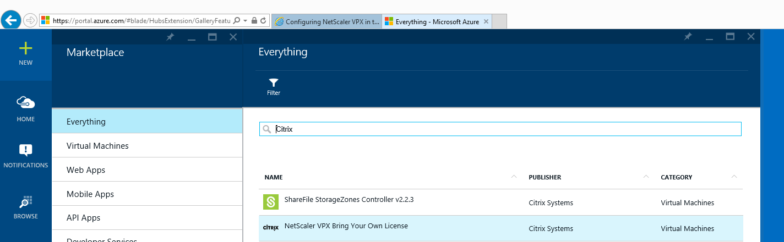
Netscaler in Azure Now
Deploy Netscaler for the new Azure portal marketplace

Slide 50
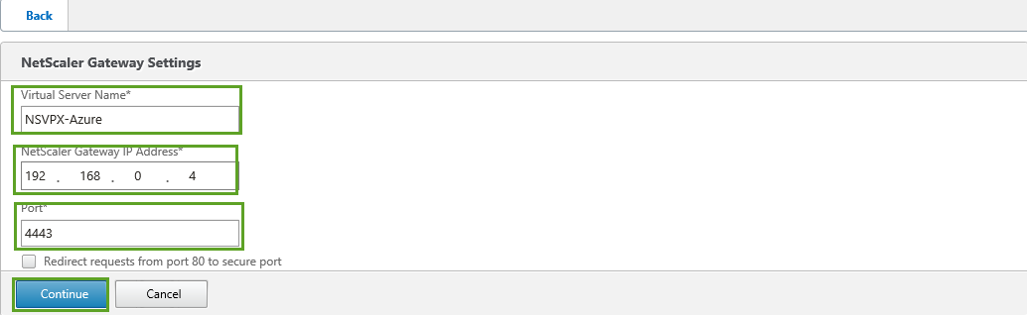
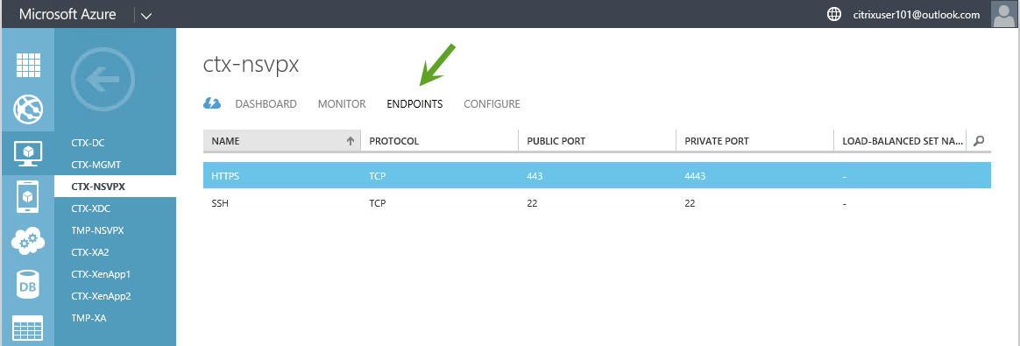
Netscaler Configuration in Azure (continued)
Configure Netscaler Gateway component
Single IP support.
Map port 443 to point to the Netscaler VM in the Azure.

Slide 51
Recipe for success
Configure your Azure topology.
Install XenDesktop infrastructure components.
Prepare and capture your golden image.
Create XenApp server VMs based on golden image.
Add XA VMs to Machine Catalog and create Delivery Group.
Install and configure Netscaler Gateway.
Configure Storefront.

Slide 52
Economics

Slide 53
Instance types evaluated by Citrix
Instance types | Virtual cores | RAM
A0 | Shared | 768 MB
A1 | 1 | 1.75 GB
A2 | 2 | 3.5 GB
A3 | 4 | 7 GB
A4 | 8 | 14 GB
A5 | 2 | 14 GB
A6 | 4 | 28 GB
A7 | 8 | 56 GB
Instance types | Virtual cores | RAM
D1 | 1 | 3.5 GB
D2 | 2 | 7 GB
D3 | 4 | 14 GB
D4 | 8 | 28 GB
D11 | 2 | 14 GB
D12 | 4 | 28 GB
D13 | 8 | 56 GB
D14 | 16 | 112GB
Notes:
Assessment was based on LoginVSI (for the XA servers)
Validated A0 thru A7 (session-based delivery)
Tested the light and medium workloads (loginVSI 4.0)
Validated D1 thru D14 (session-based delivery)
Tested the Task-worker, Office-worker and knowledge-worker workloads (loginVSI 4.1)

Slide 54
Scale numbers by Azure instance type
Notes:
Find the right fit VM… more expensive / more powerful doesn’t necessary get you better performance

Slide 55
Scale numbers by Azure instance type
* D instance type validation is still in progress and these are not final numbers

Slide 56
Instance types - cost
Instance types | Price per hour
A0 | 0.02
A1 | 0.09
A2 | 0.18
A3 | 0.36
A4 | 0.72
A5 | 0.33
A6 | 0.66
A7 | 1.32
Instance types | Price per hour
D1 | 0.171
D2 | 0.342
D3 | 0.684
D4 | 1.368
D11 | 0.403
D12 | 0.806
D13 | 1.451
D14 | 2.611
Notes:
Assessment was based on LoginVSI (for the XA servers)
Validated A0 thru A7 (session-based delivery)
Tested the light and medium workloads (loginVSI 4.0)
Validated D1 thru D14 (session-based delivery)
Tested the Task-worker, Office-worker and knowledge-worker workloads (loginVSI 4.1)

Slide 57
Instance types - cost
Instance types | Price per hour *
A0 | 0.02
A1 | 0.09
A2 | 0.18
A3 | 0.36
A4 | 0.72
A5 | 0.33
A6 | 0.66
A7 | 1.32
Instance types | Price per hour *
D1 | 0.171
D2 | 0.342
D3 | 0.684
D4 | 1.368
D11 | 0.403
D12 | 0.806
D13 | 1.451
D14 | 2.611
* These prices are for Standard instances in US West region as of 1/27/2015
Source http://azure.microsoft.com/en-us/pricing/details/virtual-machines/

Slide 58
Cost model* by Azure instance type (1)
* This price reflects the total Azure infrastructure costs (no Citrix/Microsoft licensing included)

Slide 59
Cost model* by Azure instance type (2)
* This price reflects the total Azure infrastructure costs (no Citrix/Microsoft licensing included)

Slide 60
Demo
Excel Calculator

Slide 61

Useful References
Description | Link
Citrix & Azure solutions | http://www.microsoftandcitrix.com/Solutions/AzureCloud.aspx
Azure scale paper | http://www.microsoftandcitrix.com/Documents/Citrix%20XenApp%207.5%20on%20Azure.pdf
Cost Calculator | http://microsoftandcitrix.com/Documents/XA_XD_Azure_Calculator%20(version%206%20Customer%20Release).xlsm
Citrix Workspace Cloud | http://www.citrix.com/products/workspace-cloud/overview.html
Citrix Service Provider | http://www.citrix.com/partner-programs/service-provider.html
Private cloud solutions | http://www.citrix.com/go/xendesktop-for-the-private-cloud.html
Netscaler in Azure | http://support.citrix.com/proddocs/topic/netscaler-vpx-10-5/nsvpx-azure.html

