Slide 1
About this Citrix Products on Azure Presentation
Speaker | Name(s)
Presentation Title | Citrix Solutions on Microsoft Azure
Presentation Length | 30-45 Minutes
Audience | This deck is built to support the growing initiative of Citrix solutions on Microsoft Azure cloud platform: Audience should target C-level executives and IT decision makers Goal of the deck is to review and showcase the overarching view of customer drivers to the cloud. Provide context around Citrix products (XenApp, ShareFile, NetScaler) on Microsoft Azure and how we meet todays business and IT needs and identify the benefits of deploying Citrix on Azure.
Next Steps | See slide 31
More Information | WW Alliance: John Smale (john.smale@citrix.com ) AMS: Brian Kobleur (brian.kobleur@citrix.com) EMEA: Lasse Carthberg (lasse.carthberg@citrix.com) APAC: Steve McLoughlin (steve.mcloughlin@citrix.com) Japan: Toshiaki Ito (toshiaki.ito@citrix.com)

Slide 2
Powering new ways to work in the Azure cloud
Securely deliver mobile workspaces
Notes:
<<Next>>

Slide 3
Perspective
Citrix embraces the cloud
Citrix solution on Azure
Business drivers to the cloud
Customer success
Call to action
Citrix on Azure
Notes:
<<Next>>

Slide 4



Cloud Adoption is Booming
11%
65%
35%
By 2016, there will be an 11% shift of IT budget away from traditional IT delivery
By 2016, more than 65% of enterprise IT will commit to hybrid cloud technologies
By 2017, 35% of new app will be cloud-enabled, continuous delivery and DevOps for faster rollout
* Computerworld 2015
Notes:
Slide Goal/Message: To communicate that the cloud is driving adoption across all industries today
SCRIPT: Today, cloud adoption is booming across all industry sectors. You can see that:
By 2016, there will be an 11% shift of IT budget away from traditional in-house IT delivery, towards various versions of cloud computing as a new delivery model
More than 65% of enterprise IT organizations will commit to hybrid cloud technologies before 2016, vastly driving the rate and pace of change in IT organizations
By 2017, 35% of new applications will use cloud-enabled, continuous delivery and DevOps lifecycle for faster rollout of new features and business innovation
<<Next>>

Slide 5


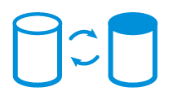

Business Drivers to the Cloud
Cloud Scalability
Cloud Economics
Focus on your Core Business
Business Continuity/
Disaster Recovery
Testing and Development
Notes:
Slide Goal/Message: Establish that there are core business drivers that customers are seeing today that Citrix on Azure can solve for
SCRIPT:
There are many business drivers for the cloud. Ultimately, it’s about
Cloud Scalability: Deploying in the cloud allows companies to “turn up” resources to cope with increased demand then “turn down” when the demand passes. This elasticity – the ability to “cloud burst”.
Cloud Economics: Tied closely with cloud scalability organizations can see significant more cost-savings than buying hardware that is only used for a short portion of any given year
Focusing on your core business: lack of available systems, real-estate, personnel or expertise – by providing companies with dynamic resources available elastically and on-demand, with dedicated experts working as an extension of the customer’s IT department allows organizations to focus what matters most, their business
Business Continuity/Disaster Recovery: Keeping the organization running if they cannot access their building(s) or their technology resources
Testing and development: The ability to spin up production quality environments to write code and for User Acceptance Testing – with the ability to migrate easily into a live environment – for a limited amount of time, is a compelling driver for cloud
<<Next>>

Slide 6
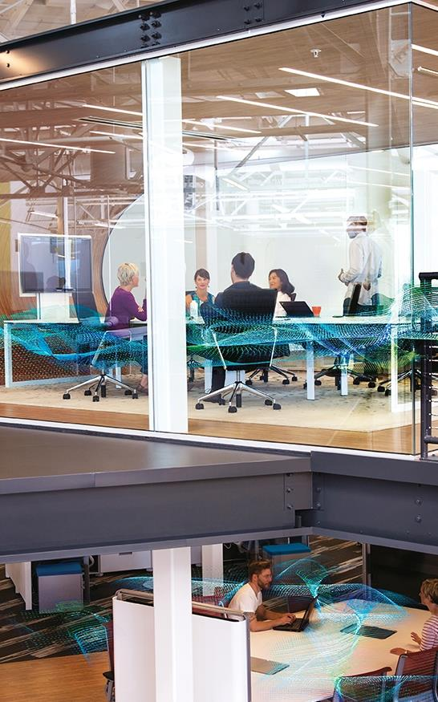
Overcoming the Cloud Hurdles
Are you in full compliance with regulatory requirements?
How do you ensure the highest level of security?
Have you optimized integration with existing environments?
Are there any other uncertainties?
Notes:
Slide Goal/Message: Even though there are huge cloud drivers and compelling reasons for cloud adoption, organizations still have major hurdles to get over prior to deploying a solution company wide
SCRIPT:
Studies have found that more than 90 percent of organizations are already running cloud applications, or at the very least they are experimenting with cloud adoption. For 82 percent of these companies, a hybrid cloud strategy is following. Regardless of the cloud adoption methods, the cloud is being implemented, and it is imperative that organizations identify their hurdles in order to build a plan for adoption to guide through the process.
Projects that must take priority during the adoption process:
Cloud governance
Cloud security and security policies
Optimization and integration testing for your existing environment
And additional uncertainties such as risk, cloud infrastructure, cloud architecture, compliance processes
<<Next>>

Slide 7

Citrix Embraces the Cloud
Notes:
<<Next>>

Slide 8
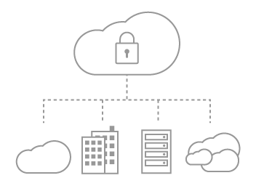
Citrix Embraces the Cloud Experience
Citrix delivers cloud
services on-premises
Citrix is hybrid
by nature
Delivering Citrix
as-a-Service
Notes:
Slide Goal/Message: Citrix depicting its journey to the cloud staring with delivering cloud services on-premises
SCRIPT:
Citrix has always been committed to the cloud. Our on-premises solution has been a private cloud from the beginning.
When Citrix started, distributed PCs were the norm, but we thought bigger and we thought server-based computing and centralized apps and data to make information access as simple as a phone call for anyone, anywhere, anytime, and build a virtual workplace.
<<Next>>

Slide 9
Citrix Embraces the Cloud Experience
Citrix delivers cloud
services on-premises
Citrix is hybrid
by nature
Delivering Citrix
as-a-Service
Notes:
Slide Goal/Message: Step two Citrix available on Azure with the BYOL options for customers
SCRIPT:
Citrix now provides options for customers to bring their own licenses.
The Citrix you know and love, with the Citrix licenses you already own.
<<Next>>

Slide 10
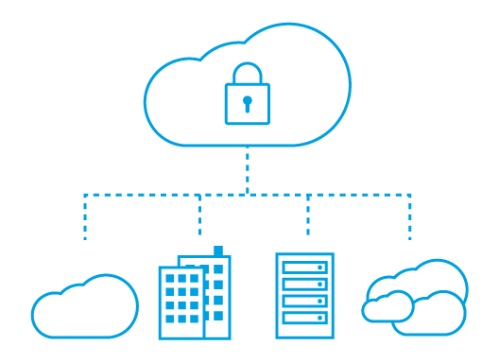
Citrix Embraces the Cloud Experience
Citrix delivers cloud
services on-premises
Citrix is hybrid
by nature
Delivering Citrix
as-a-Service
Notes:
Slide Goal/Message: Citrix Workspace Cloud - the next step to the cloud. Subscription model.
Change is the only constant and Citrix is enabling new ways of working, continuing to make IT simpler, and help people work better
SCRIPT:
Today Citrix is the backbone for the worlds largest clouds. Enabling business to grow and thrive in this always changing world. Citrix is providing the worlds most comprehensive workspace platform so everything works simply, seamlessly, and securely across devices, locations, and networks. Today we are enabling a new mobile workforce with Citrix-as-a-Service allowing people to work on their own terms and focus on what really matters, enjoying their lives work
<<Next>>

Slide 11
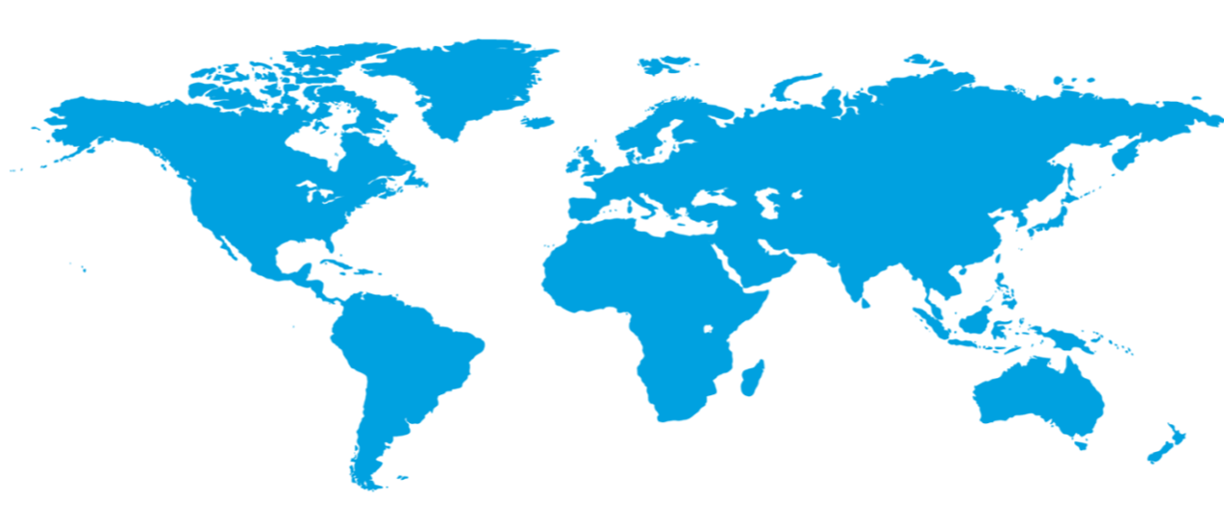

Azure Supporting the Citrix Experience
  100+ datacenters
  2x AWS and 6x Google number of offered regions
  One of the top 3 networks in the world
  Azure is the ideal enterprise-grade public cloud
Huge datacenter capacity across 19 worldwide regions with Citrix
Operational
Announced
Notes:
Slide Goal/Message: Azure is a great cloud for Citrix
SCRIPT:
Who better than Microsoft to run your datacenter?
There are over thirty-five factors in site selection criteria. But really, the top elements are around proximity to customers, energy, and fiber infrastructure, ensuring that the capacity and the growth platforms can grow our joint services. Intentionally located.
Infrastructure by the numbers:
100+ datacenters
SLA uptime 99.95%
One of the top 3 networks in the world (coverage, speed, connections)
2x AWS and 6x Google number of offered regions
G Series – Largest VM available in the market – 32 cores, 448GB Ram, SSD…
<<Next>>

Slide 12
Citrix Solutions on Azure

Slide 13
Citrix at a Glance
Deliver
Unify
Broadcast
Integrate
Software-Defined
Datacenter
Traditional & Converged
Infrastructure
Infrastructure as-a-service
Public Cloud
Irresistible experience. Secure data. Any device. Any app. Any cloud.
Notes:
Slide Goal/Message: Prior to jumping into the next set of slides, we want to remind the customer what Citrix is about and that now you can do it on Azure. Delivering Citrix software-defined workplace to deliver the best solution anywhere at anytime
SCRIPT:
This is what Citrix does
Now we can do this on Azure cloud
<<Next>>

Slide 14
Citrix Solutions on Azure
Enterprise App Delivery
Cloud Networking
Enterprise File Sync and Share
Citrix-as-a-Service
Centralize control
Increase mobility
Enable cloud management
Enhance load balancing
Deliver network optimization
Cross-security and control
Mobilize employees
Provide anywhere access
Aggregate enterprise data
Unify administration
Smooth on-ramp to the cloud
Cross-service coordination
Notes:
Slide Goal/Message: Describe what Citrix products are on Azure
SCRIPT:
At Citrix we want to empower our customers to be able to use the infrastructure they want with the same efficiency as deploying on-premises or as Citrix-as-a-Service through Citrix Workspace Cloud.
<<Next>>

Slide 15
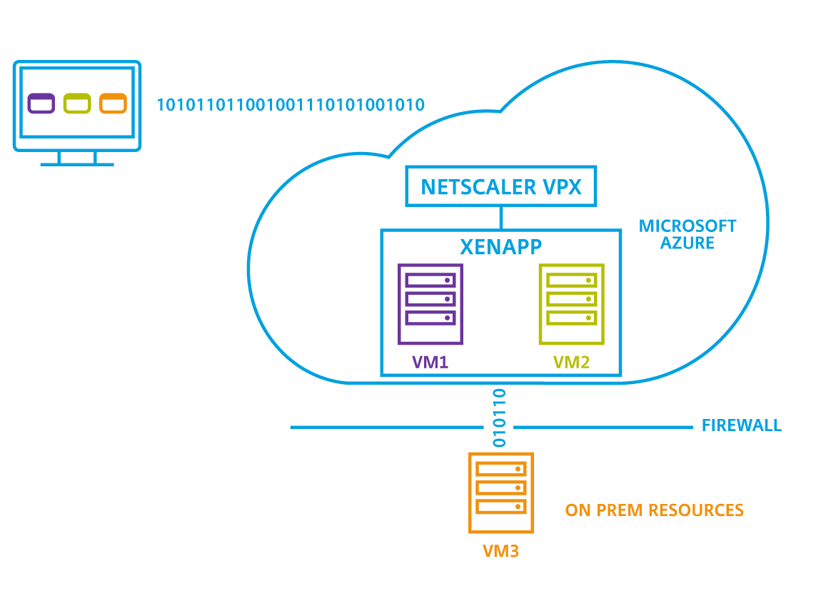

Enterprise Application Delivery on Azure
Centralize control and increase mobility with Citrix XenApp and XenDesktop
Security
Protect critical business information while empowering workforce mobility
Workload Integration
Move existing workloads to the cloud through BYO license model
Deploy in Azure as easily as on-premises, and leverage unused licenses
User Experience
Enable mobility, BYOD, and customer choice while delivering apps to users
Reduce costs and optimize the desktop experience for users anywhere
ON-PREMISES RESOURCES
Notes:
Slide Goal/Message: The powerful XenApp you are familiar with, and we support hybrid cloud deployment
SCRIPT:
XenApp workloads on a Microsoft Azure cloud give IT organizations a strategic advantage since it enables agile desktop and application delivery. No new learning curve and no added complexity, but near unlimited scale. And, as we mentioned before, the full deployment guide, available today.
By centralizing control with XenApp, you can give your team the freedom of mobility while quickly and securely delivering apps and services:
Pay for only the compute, storage, and network resources that are used.
Orchestrate, manage, and deliver both traditional and cloud workloads.
Cross-platform management: private, public, and hybrid cloud models.
Move existing and future workloads to the cloud as it makes sense for your business.
Additionally Citrix XenApp on Azure drives:
Security
Protect critical business information while empowering workforce mobility
Workload Integration
Move existing workloads to the cloud through BYO license model
Deploy in Azure as easily as on-premises, and leverage unused licenses
User Experience
Enable mobility, BYOD, and customer choice while delivering apps to users
Reduce costs and optimize the desktop experience for users anywhere
<<Next>>

Slide 16
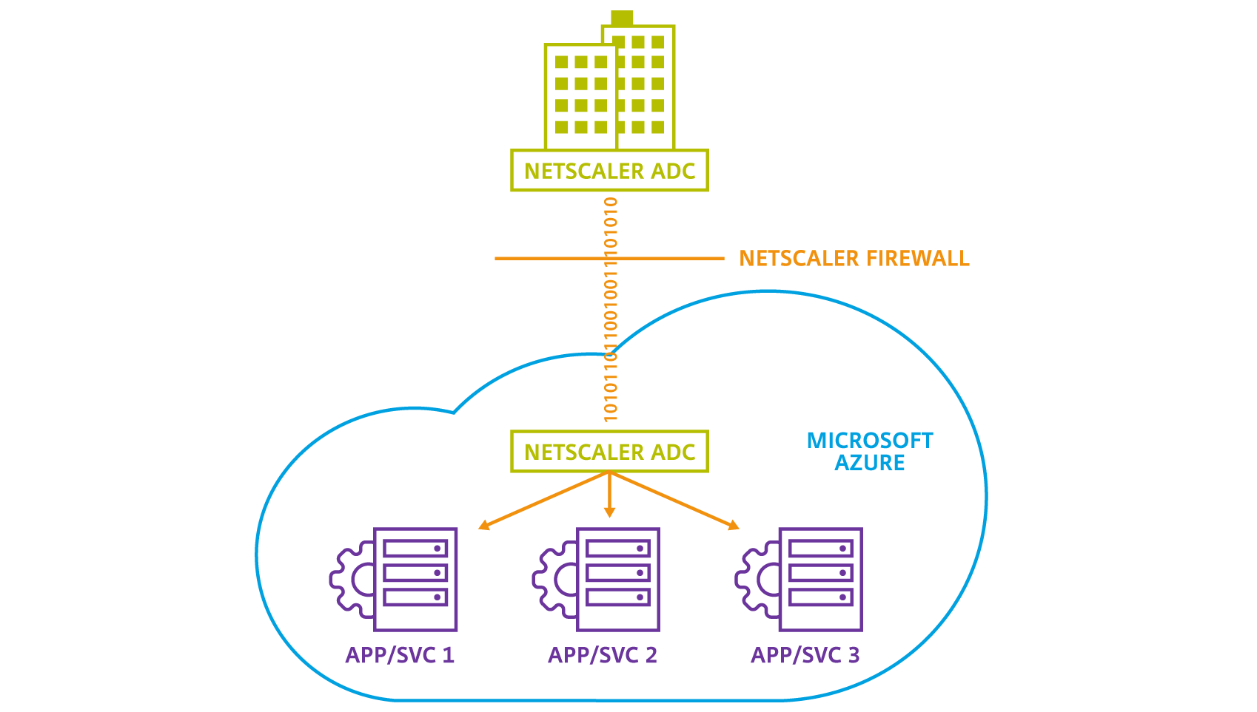
Cloud Networking on Azure
Enhance load balancing, network optimization, security, and control with NetScaler
Agility within XenApp Environments
Accelerate app performance with integrated application network services
Secure Networks
Provide authentication and authorization with Microsoft Azure Active Directory
Hybrid Cloud
Streamline management through single pane of glass across multiple networks
App Delivery and Performance
Leverage the same NetScaler binary to reduce learning curve
Notes:
Slide Goal/Message: Deliver NetScaler in the cloud to support your cloud environment.
NetScaler is available in the Azure Marketplace:
https://azure.microsoft.com/en-us/marketplace/partners/sharefile/netscaler-vpx-bring/
SCRIPT:
Cloud computing has fundamentally changed the way an enterprise deploys and uses business resources. Consequently, your network has become the single most important path to your corporate assets. Citrix NetScaler on Microsoft Azure is a L4-L7 virtual networking appliance that ensures organizations have access to secure and optimized applications and assets deployed in the cloud
Agility within XenApp Environments
Accelerate app performance with integrated application network services
Secure Networks
Provide authentication and authorization with Microsoft Azure Active Directory
Hybrid Cloud
Streamline management through single pane of glass across multiple networks
App Delivery and Performance
Leverage the same NetScaler binary to reduce learning curve
<<Next>>

Slide 17
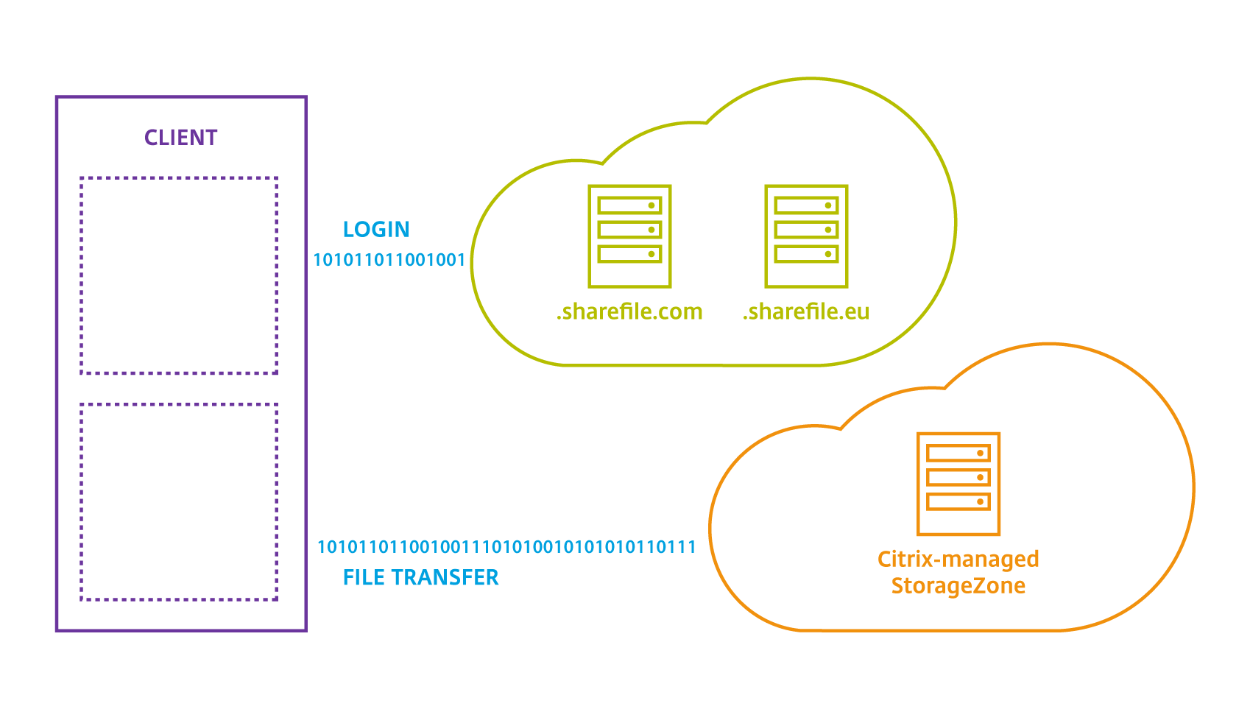







Enterprise File Sync and Share
Use ShareFile to mobilize and access enterprise data regardless of where the data is stored
Existing Integration with Infrastructure
Use ShareFile on Azure to aggregate data across multiple and disparate platforms
Centralized Data Manager
Improve collaboration and productivity through secure data sharing
Citrix Managed StorageZones
Manage StorageZones on-premises
Meet compliance and performance needs
Office 365 Integration
Link ShareFile to Office 365 for SSO from multiple Windows devices
Microsoft Azure
Notes:
Slide Goal/Message: Deliver Enterprise File Sync and Sharing on Azure.
Note: ShareFile cannot be provisioned in Azure.
SCRIPT:
An enterprise file sync and sharing service enhances user productivity, improves collaboration and ensures anytime access to data from multiple devices (desktop and mobile) while providing IT teams with data visibility and control. File sync and sharing are critical capabilities for mobile workforces whose organizations have ongoing mobility initiatives with media tablets and BYOD programs. Security-conscious organizations are facing increased demand for these capabilities, and are turning to services like ShareFile that offer a deeper focus on data security and compliance versus unsecured consumer-grade file-sharing services.
Utilize the power of ShareFile on Microsoft Azure
Existing Integration with Infrastructure
Use ShareFile on Azure to aggregate data across multiple and disparate platforms
Centralized Data Manager
Improve collaboration and productivity through secure data sharing
Citrix Managed StorageZones
Manage StorageZones on-premises
Meet compliance and performance needs
Office 365 Integration
Link ShareFile to Office 365 for SSO from multiple Windows devices
<<Next>>

Slide 18
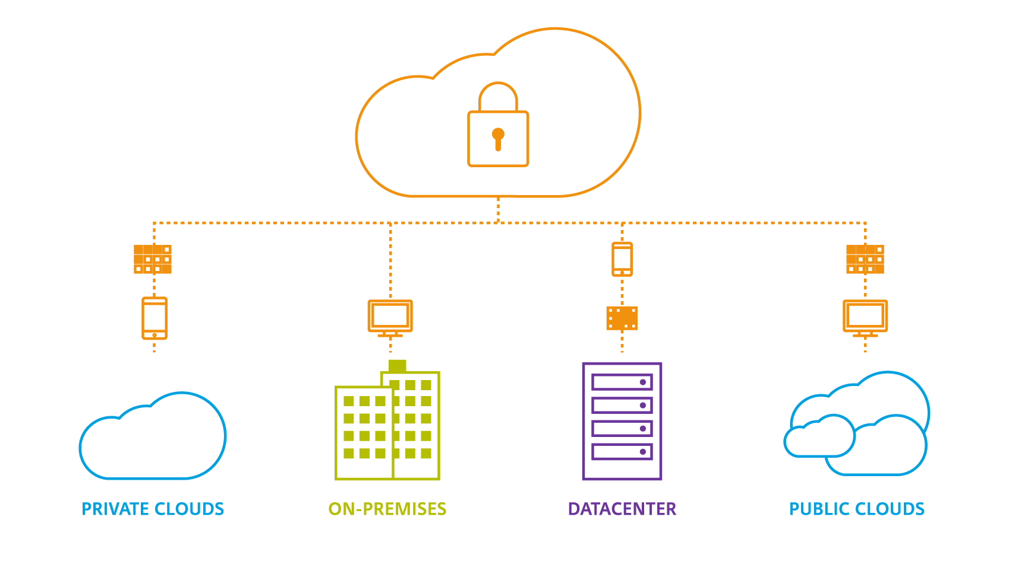
Citrix WorkSpace Cloud
Support apps of any type and access anywhere on any device
One Central Platform
One login and admin console
Entire Citrix service platform
Unified purchase experience
Continuous updates
Secure WorkSpace Service Delivery
Platform encrypts all data
A broker for information transfer
No user-identifiable data is stored
Admin-configurable data location
More than DaaS
App, data, and services integration
Other options, including server VDI
Multiple management options
On-premises, public and hybrid clouds
Notes:
Slide Goal/Message: Support applications and desktops of any type and access anywhere on any device.
Convey how you can provide XenApp on a subscription basis.
SCRIPT:
Move management to the cloud and deliver integrated desktop, app, data, and mobility services people need, wherever and however they need them. Help your business move faster while lowering IT costs.
• Cloud-based management – a simplified infrastructure and centralized control, resulting in
less to install, configure and manage. This reduces the costs of managing apps and data while
helping to protect business intellectual property.
• Design-centric approach – rather than hand-crafting and engineering, IT can design,
integrate and deploy workspace services in minutes, at cloud scale, to support any number of
locations, branch offices and global subsidiaries around the world with the same quality of
service, ease of management and improved global visibility.
• Deployment simplification – so IT can deploy workspace services onto any cloud or hybrid
infrastructure according to the best approach for each service and according to requirements.
This can include deploying enterprise file sync and sharing on-premises for data sovereignty,
Windows apps on Azure to control cost, and in the nearest location for performance-critical apps to ensure a good user experience.
• Publish/subscription model – with pre-designed and pre-configured workspaces that can be
assigned to different user groups in minutes, users can subscribe to one or more workspaces
based on their need, device or work context.
<<Next>>

Slide 19

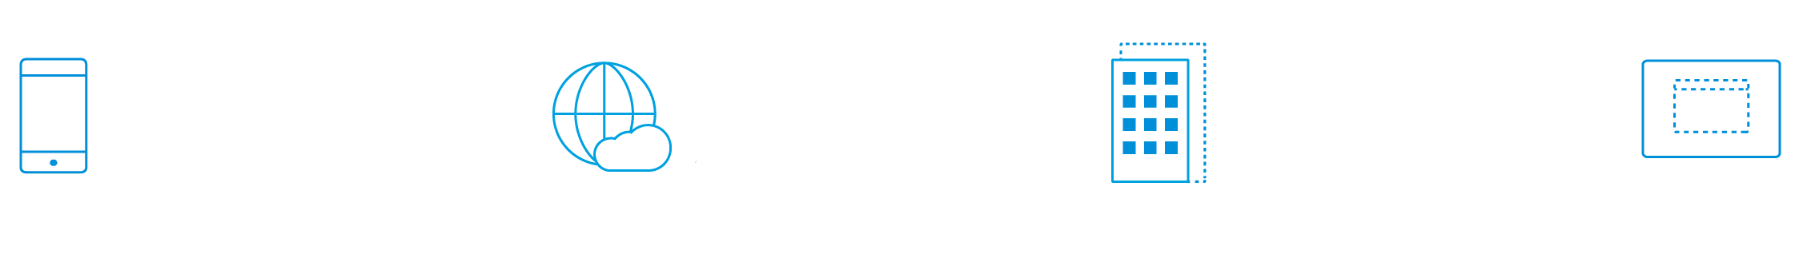
Together Citrix + Microsoft
Business and IT Transformation
Enable Mobile
Workspaces
Enhance Cloud
Networking
Simplify and
Scale Environments
Deliver Cloud Desktops and Applications
Notes:
Slide Goal/Message: This is your summary slide, together Citrix and Microsoft enable business and drive IT transformation
SCRIPT:
We enable mobile workspaces, enhance cloud networking, simplify and scale environments all while delivering cloud desktops and applications across organizations environments on-premises or in the cloud.
<<Next>>

Slide 20
Business Drivers to the Cloud

Slide 21
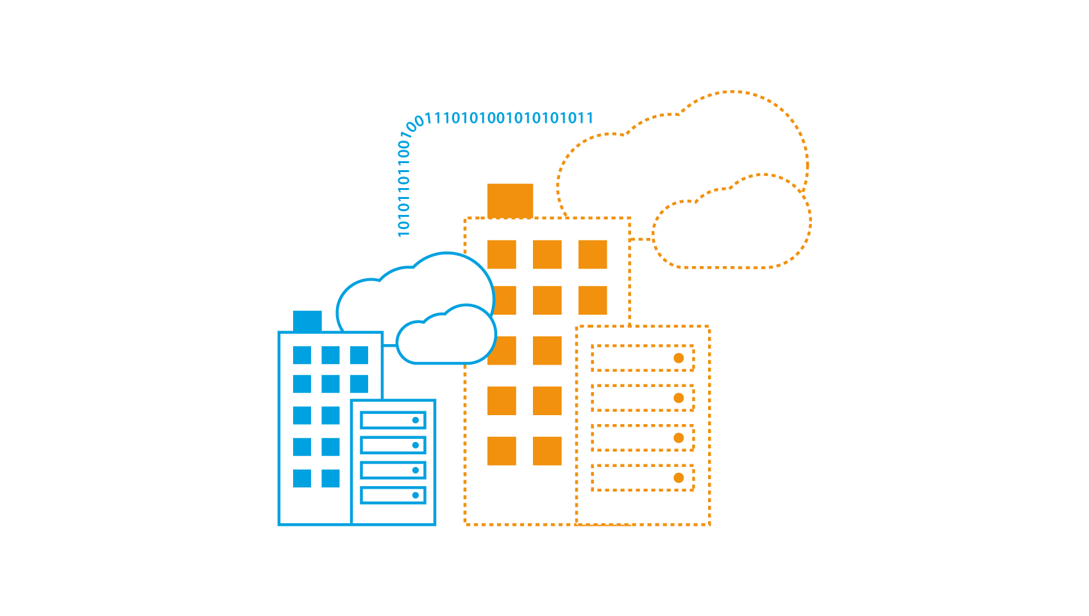
Cloud Scalability
Grow environments with Azure as infrastructure for Citrix-powered desktops and applications
Capacity on-Demand
Efficiently scale up and scale down apps and environments to meet any business seasonality
Host XenApp on Azure to reduce capital expenses and scale as needed
Simplify IT management across on-premises and cloud by providing a hybrid cloud solution
Reach and scale XenApp and XenDesktop farms by bringing app sessions closer to user locations
Notes:
Slide Goal/Message: Grow environments with Azure as infrastructure for Citrix powered desktops and applications
SCRIPT:
Customers can leverage Azure public cloud infrastructure to increase capacity on-demand during peak usage periods throughout the year. Once demand wanes, they can take environments down and return to normal operations. Using Azure as infrastructure for a Citrix-powered desktop and app solution allows customers to grow the environment gradually and predictably without having to over-size a solution for the worst-case load scenarios.
Provisioning the user environment.
Seasonality for workloads such as:
H&R Block - tax preparation time
Best Buy – during the holidays
Education – setting up new classrooms, how much capacity will be needed
Mergers and acquisitions – i.e. if Dell runs XenApp they will have no problems when they acquire EMS
With our joint solution you can drive Capacity on-Demand:
Efficiently scale up and scale down apps and environments to meet any business seasonality
Host XenApp on Azure to reduce capital expenses and scale as needed
Simplify IT management across on-premises and cloud by providing a hybrid cloud solution
Reach and scale XenApp and XenDesktop farms by bringing app sessions closer to user locations
<<Next>>

Slide 22
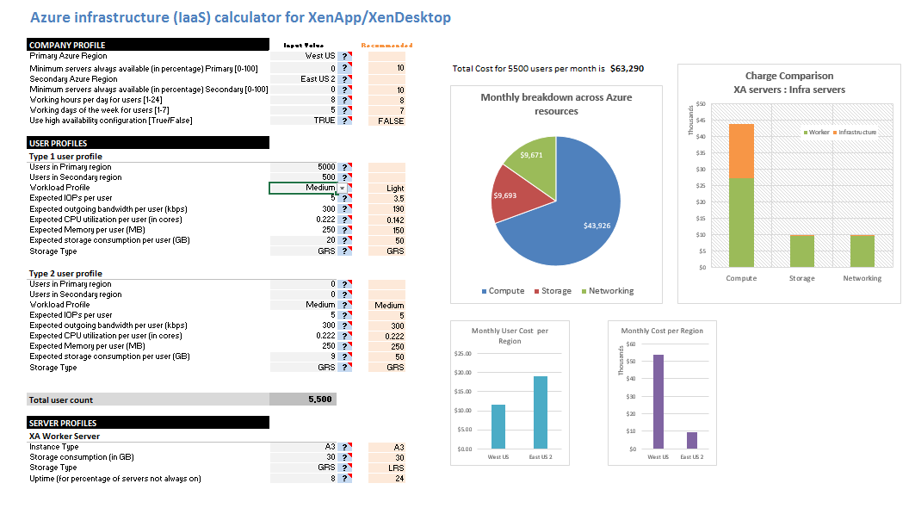
Cloud Economics
Driving down overall cost without sacrificing your business operations
Cost-Efficient Cloud
  Calculate your costs and subscription of deploying Citrix on Azure with the Citrix Cost Calculator
Reduce capital expenses and maximize investments
Use Azure management interface to manually shut down and de-allocate virtual machines that are not active
Expand business in the cloud at the pace of growth without the cost of additional infrastructure
Notes:
Slide Goal/Message: Driving down overall cost without sacrificing business operations
SCRIPT:
Companies that are moving select IT capabilities to the cloud are saving money and increasing profits, which they are putting back into the business to increase headcount, boost wages and drive innovation.
With our joint solution you can drive a cost-efficient cloud
Calculate your costs and subscription of deploying Citrix on Azure with the Citrix Cost Calculator
Reduce capital expenses and maximize investments
Use Azure management interface to manually shut down and de-allocate virtual machines that are not active
Expand business in the cloud at the pace of growth without the cost of additional infrastructure
<<Next>>

Slide 23
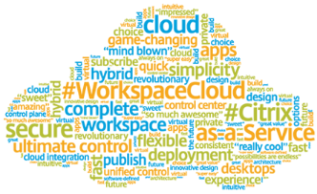
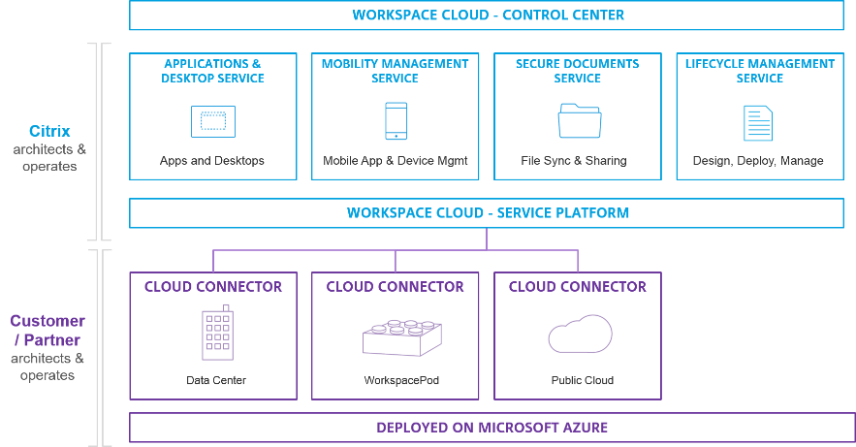
Focusing on your core business competencies
Flexible architecture that easily adapts to new use cases and technology for your business
Provide Business Competencies
Cloud-Based:
  Operate a cloud-based service
Management Services:
  Shift management of services into the cloud
  Customers and partners control where to locate data and virtual machines for apps and desktops
Integration and Delivery:
  WorkSpace Cloud automatically integrates across services ensuring a consistent experience
  Citrix infrastructure is patched and up-to-date across all products
Notes:
Slide Goal/Message: Flexible architecture that easily adapts to new use cases and technology for any business. Talk about reducing the overhead and how CWC alleviates this.
SCRIPT:
Citrix Workspace Cloud now provides the first fully integrated way to deliver cloud-based service. Workspace Cloud also has the unique ability to work with both existing data centers and the world’s best clouds, giving customers complete control over workspace locations, security, performance, cost and data sovereignty. As an inherently multi-cloud, hybrid cloud, multi-site solution with no cloud vendor lock-in, Workspace Cloud offers a better way to adopt any cloud and a low-risk entry point for companies new to cloud-based workspace delivery.
With our joint solution you can drive core business competencies
Cloud-Based:
Operate a cloud-based service
Management Services:
Shift management of services into the cloud
Customers and partners control where to locate data and virtual machines for apps and desktops
Integration and Delivery:
WorkSpace Cloud automatically integrates across services ensuring a consistent experience
Citrix infrastructure is patched and up-to-date across all products
<<Next>>

Slide 24
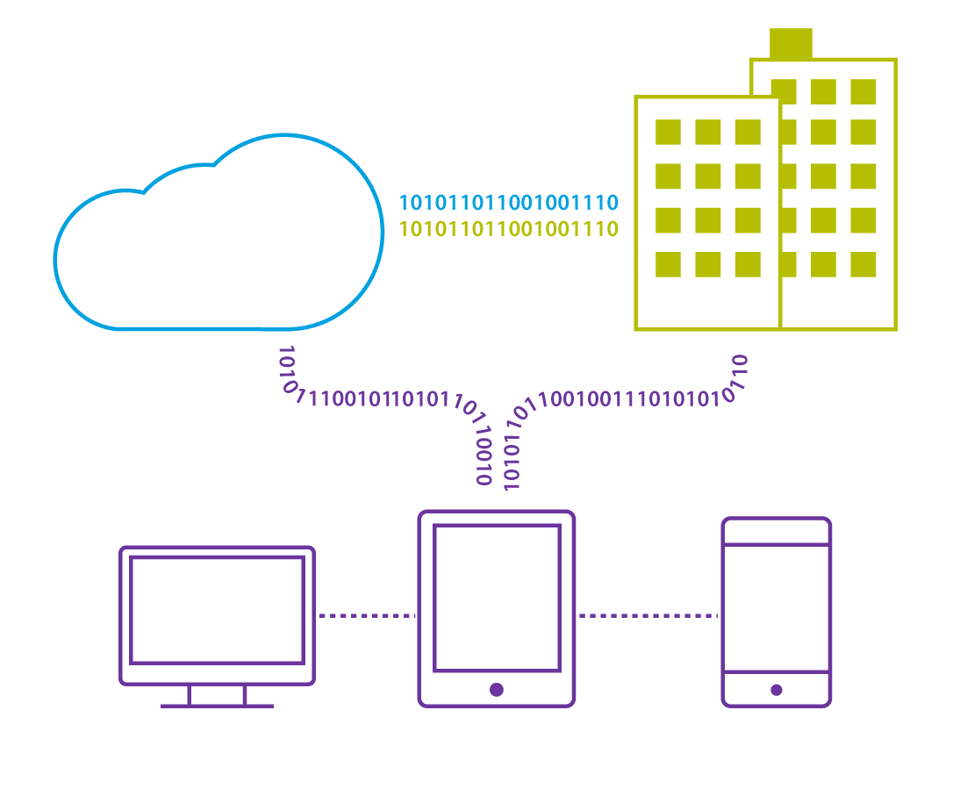
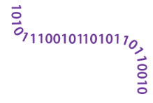
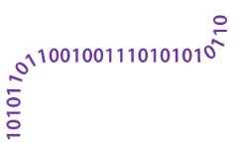
Business Continuity and Disaster Recovery
Deliver instant, easy failover with minimal impact on user experience
On-Demand Availability
Provide secure access powered by Citrix NetScaler Gateway on Azure
Transform Windows apps and desktops into on-demand services delivered to any device, in any location
Securely share files with anyone and sync files across all devices
Redirect to other app sources and update XenApp
Provide exceptional user availability regardless of circumstances
Notes:
Slide Goal/Message: Deliver instant, easy failover with minimal impact on user experience. Convey the ease with which Citrix helps you do this.
SCRIPT:
Every organization faces the possibility of major or minor disruptions of all kinds, from planned events such as IT maintenance and office relocations, to looming emergencies such as hurricanes, snow storms and epidemics, to unplanned events that strike completely without warning.
It is no wonder business continuity, and disaster recovery are strategic functions for organizations to take seriously.
Citrix on Azure lets users connect to apps, desktops, files and services in both routine operations and emergency situations. This makes it simple for people to do whatever their priorities dictate - whether to continue normally working , perform new tasks required by the event, or focus on the needs to resume business as usual.
With our joint solution you can deliver business continuity and disaster recovery with on-demand availability
Provide secure access powered by Citrix NetScaler Gateway on Azure
Transform Windows apps and desktops into on-demand services delivered to any device, in any location
Securely share files with anyone and sync files across all devices
Redirect to other app sources and update XenApp
Provide exceptional user availability regardless of circumstances
<<Next>>

Slide 25
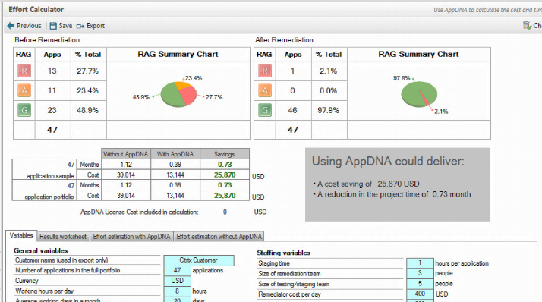
DevOps / Application Lifecycle Management
Accelerate application migration and simplify application management
Ensure Quality Prior to Going Live
AppDNA
Reduces time, cost, risk, and disruption by testing workloads in Azure
Automates and streamlines the app compatibility and migration process
Test app compatibility with Windows 10 OS
Leverage XenApp for upgrades to newer OS, or to test LOB applications
NetScaler
Speeds test environment time-to-production on Azure
Accelerates time-to-market by allowing IT to access development resources on-demand
Notes:
Slide Goal/Message: Accelerate application migration and simplify application management
SCRIPT:
Cloud services accelerate time-to-market by allowing IT to access development resources on-demand without the need to provision physical servers and other hardware.
Continuous integration, automated deployments, and standardized production environments let you get the minimum viable product up and running, and expose it to users immediately. This lets customers get their hands on a new feature and get creative with what solution it really provides for them. This is a powerful competitive advantage for any company reliant on winning market share and demonstrating to customers that they are on top of their game and intent on providing real value fast! This also opens up more revenue streams for a business, and with that you can plan better for the future.
With our joint solution you can ensure quality prior to going live
AppDNA
Reduces time, cost, risk, and disruption by testing workloads in Azure
Automates and streamlines the app compatibility and migration process
Test app compatibility with Windows 10 OS
Leverage XenApp for upgrades to newer OS, or to test LOB applications
NetScaler
Speeds test environment time-to-production on Azure
Accelerates time-to-market by allowing IT to access development resources on-demand
<<Next>>

Slide 26
Customer Success

Slide 27
Azure simplified a lot of the tasks that are required to implement a Citrix infrastructure. Having a lean IT environment allows us to respond to user demand in a more agile and faster manner than what we’ve ever done in the past
Nick Kuennen
Pella Corporation, Microsoft System Administrator
Notes:
Slide Goal/Message: Convey how to run mission-critical applications by leveraging Azure, deliver the same SLA with Azure as Pella has in their on-premises environment.
SCRIPT:
Specifically, Pella wanted to bring customers/users faster to market and improve customer support
Tested the feasibility of deploying 10-15 year old mission-critical legacy apps (one was image heavy), which had not been updated for many years
Pella updated/modernized the on-premises version to the latest version of XenApp and pushed the client to Azure.
Deploying XenApp on Azure can be very beneficial for customers who:
Are not highly virtualized will typically see large cost savings. (If they have little cloud experience they may not realize the full savings)
Are highly siloed, because cloud virtualization will break down the silos
Have high volatility to seasonality
Key areas where Citrix for Azure excels:
Burst, seasonality, disaster recovery, app lifecycle management, development and testing
From Citrix point of view, customers get infinite scale by moving to the cloud. The benefits come from Citrix being in the mix, since the benefits are the same on-premises as in the cloud/Azure.
<<Next>>

Slide 28
Being able to use NetScaler in Azure is a critical piece to the deployment of XA 7.6 in Azure. Making a transition into Azure simplifies a lot of tasks that are required to implement Citrix infrastructure. Lean IT allows us to respond to user demand in a more agile and faster manner
Nick Kuennen
Pella Corporation, Microsoft System Administrator

Slide 29
Call to Action

Slide 30

Next Steps / CTA
Understand your business drivers, determine which model makes the most sense
Evaluate which applications are good migration candidates
Understand your business drivers, determine which model makes the most sense
Do a POC and determine costs
Expand deployment
Evaluate which applications are good migration candidates
Do a POC and evaluate costs
Expand deployment

Slide 31
Learn More
Resources
Citrix and Azure
Citrix powered apps and desktops from the Windows Azure Cloud
Citrix ShareFile on Microsoft Azure
Mobilize enterprise data with Citrix ShareFile on Microsoft Azure
XenApp on Azure
Deploying XenApp on Microsoft Azure cloud
NetScaler on Microsoft Azure
Lights up applications in the cloud
Citrix on Azure Cost Calculator
Calculating the cost and subscription of deploying Citrix on Azure
Watch
Microsoft and Citrix
Better Together Story
Extending Microsoft Azure through Citrix
Does it work?
ShareFile on Azure
Mobilizing enterprise data with Citrix ShareFile and Microsoft Azure
Getting Started
NetScaler VPX on Azure Marketplace
NetScaler - Azure Marketplace
ShareFile StorageZones on Azure Marketplace
ShareFile - Azure Marketplace

