Slide 1
SYN406, Architecting Citrix for Google Compute Cloud
May 2015
Peter Bats
Sr. Solutions Architect

Slide 2
Tweet about this session with hashtag
#SYN406 and #citrixsynergy
Follow me @Peter_Bats
Notes:
Feel free to tweet about this session with the following hashtags!

Slide 3








Proudly Dutch
Lives in Italy – Turin / Alpes
VMS Ambassador, Windows NT Wizard, XenGuru

Slide 4
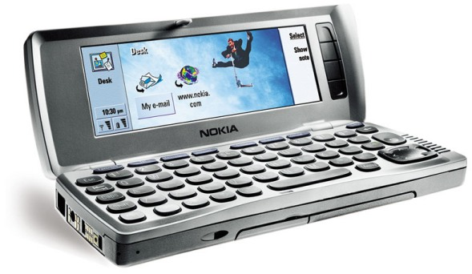






Slide 5
Session Objectives And Takeaways
Session Objective(s):
  Understand architectural considerations when building out a Citrix infrastructure in GCE
  Highlight some deployment essentials to make it work for you
  Discuss scale and economics
You can build a fully functional XenApp / XenDesktop 7.6 in GCE today
Applications, Sessions and Server VDI are all available
Notes:
This slide is required. Do NOT delete. This should be the first slide after your Title Slide. This is an important year and we need to arm our attendees with the information they can use to Grow Share! Please ensure that your objectives are SMART (defined below) and that they will enable them to go in and win against the competition to grow share. If you have questions, please contact your Track PM for guidance. We have also posted guidance on writing good objectives, out on the Speaker Portal (https://www.mytechready.com).
This slide should introduce the session by identifying how this information helps the attendee, partners and customers be more successful. Why is this content important?
This slide should call out what’s important about the session (sort of the why should we care, why is this important and how will it help our customers/partners be successful) as well as the key takeaways/objectives associated with the session. Call out what attendees will be able to execute on using the information gained in this session. What will they be able to walk away from this session and execute on with their customers.
Good Objectives should be SMART (specific, measurable, achievable, realistic, time-bound). Focus on the key takeaways and why this information is important to the attendee, our partners and our customers.
Each session has objectives defined and published on www.mytechready.com, please work with your Track PM to call these out here in the slide deck.
If you have questions, please contact your Track PM. See slide 5 in this template for a complete list of Tracks and TPMs.

Slide 6
Demo
Whirlwind Tour of Google Cloud Platform
Google Compute Engine
Using XenDesktop and Compute Engine (demo)
What is Next?
Agenda

Slide 7
Demo
Does it work

Slide 8
Overview
Google Cloud Platform

Slide 9
Google Cloud Platform

Slide 10
What is Google Cloud Platform
The best way how Google share their
  Cloud Infrastructure
  Cloud Knowledge
  Cloud Engineers
Your own data center, with minimum cost as possible as it could be

Slide 11
You will be using Google’s Infrastructure
  Virtual Machines
  Networking
  Storage
And be placed in a safe place
  Google’s Data Center
And Google will do those for you
  Scaling
  Migrating
  Maintenance
  Take over anything you don’t wanna do

Slide 12
Manage all API services on Google Cloud
(e.g. Translation API, Prediction API, Maps API...)
Compose equivalent commands for:
Command-line tools (Google Cloud SDK)
RESTful API
Dashboard for monitoring all
resources on Google Cloud Platform

Slide 13
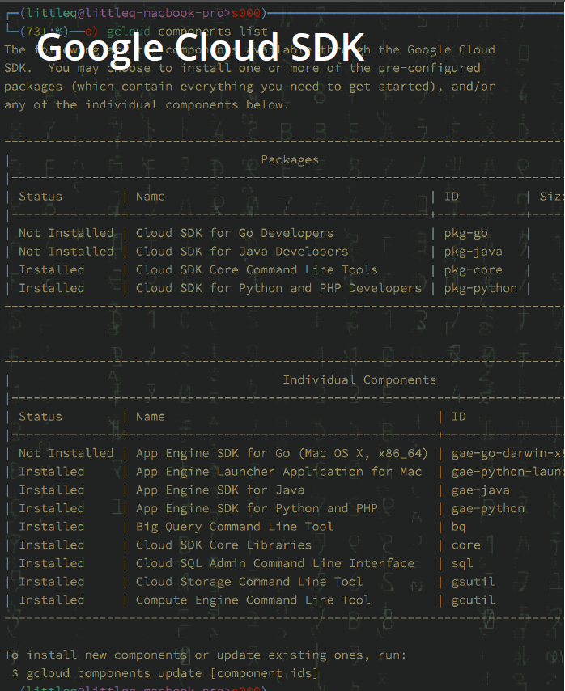
Install/uninstall/upgrade all
command-line tools related to
Google Cloud Platform
Notification for new release of any
Cloud SDK component
Automatization

Slide 14



Storage
Storage Services in Google Cloud Platform

Slide 15

Cloud SQL
It’s MySQL, but managed by Google
Relational Data Storage on Google Cloud
Use Cases
LAMP Applications
Google App Engine

Slide 16
Cloud Datastore
Non-Relational database (NoSQL)
Schema-less data
Use Cases
Highly Scalable application

Slide 17
Cloud Storage
Protected
Your data is protected at multiple physical locations
Strong, configurable security
OAuth or simple access control on your data
Multiple usages
+ Serve static objects directly
+ Use with other Google Cloud products (Bridge)

Slide 18

Google Compute Engine
Infrastructure-as-a-Service in Google Cloud Platform

Slide 19
Infrastucture-as-a-Service
Google has resources
+ CPU Cores
+ Memory
+ Networking
+ Persistency (Disks, Snapshot, Cloud Storage...)
+ Well-trained engineering monkeys
You have business and be busy

Slide 20
Google Compute Engine
High-performance virtual machines
from micro-VM to large instance
Powered by Google's global network
you could build a large cluster with strong and consistent bandwidth, provided by
Google
Load Balancing
spread incoming traffic across instances
Fast Bullet Reloading
quick deployment of large VMs
command-line interface
web-based console
Highly secured
All data written to disk in Compute Engine will be encrypted by high-class
encryption algorithm

Slide 21
Instances on GCE
KVM-based Virtual machines
Fast booting time
routinely takes less than 30 secs
Various OS support
Various machine types
http://gce-demos.appspot.com

Slide 22







Operating Systems
Windows
  Windows 2008R2 SP1
  Windows 2012 R2
Linux
  OpenSuse
  SLES
  RHEL
  CentOS
  Debian
  Ubuntu

Slide 23
Google Compute Engine Units (GCEUs)
A unit of CPU capacity used to describe the compute power of instance types
2.75 GCEUs = 1 minimum power of 1 logical core on Sandy Bridge platform
=

Slide 24
Machine Types (Shared-Core)
f1-micro
Shared Core
0.6 GB Memory
g1-small
1 Core
1.7 GB Memory
1.38 GCEUs

Slide 25
Machine Types (Standard)
n1-standard-n
Starts from 1 Core
Start from 3.75 GB Memory
n | Virtual CPUs | Memory | GCEUs
1 | 1 | 3.75GB | 2.75
2 | 2 | 7.50GB | 5.50
4 | 4 | 15GB | 11
8 | 8 | 30GB | 22
16 | 16 | 60GB | 44
32^{Beta} | 32 | 120GB | 88

Slide 26
Machine Types (High Memory)
n1-highmem-n
Starts from 2 Core
Start from 13 GB Memory
n | Virtual CPUs | Memory | GCEUs
2 | 2 | 13GB | 5.50
4 | 4 | 26GB | 11
8 | 8 | 52GB | 22
16 | 16 | 104GB | 44
32^{Beta} | 32 | 208GB | 88

Slide 27
Machine Types (High CPU)
n1-highcpu-n
Starts from 2 Core
Start from 13 GB Memory
n | Virtual CPUs | Memory | GCEUs
2 | 2 | 1.80GB | 5.50
4 | 4 | 3.60GB | 11
8 | 8 | 7.20GB | 22
16 | 16 | 14.4GB | 44
32^{Beta} | 32 | 28.2GB | 88

Slide 28
Regions and Zones
europe-west1-b
europe-west1-c
europe-west1-d
us-central1-a
us-central1-b
us-central1-c
asia-east-a
asia-east-b
Singapore?

Slide 29
Live Migration
Transparent Maintenance
Auto restart instances shutdown by system events
During transparent maintenance, you could set GCE to your instances in two ways:
  Live Migrate
  Affect performance in some degree
  but your instances remain online (no downtime)
  Terminate and reboot

Slide 30
Persistent Disk
Virtual SCSI device
Block Storage
Persistent until deleted
Hot-Plug to GCE instances (attach/detach)

Slide 31
Load Balancing
Target Pools
Health Checking
Forwarding Rules

Slide 32
Persistent IP Addresses
GCE reserved IP for instance, won’t change with the reboot of VMs
You can promote ephemeral IP to persistent IP
No DNS changing anymor

Slide 33
Architecture
Basic architecture (quick jumpstart topology)
Simple GCE only
Simple Hybrid
Extended architecture
Scale
Availability

Slide 34


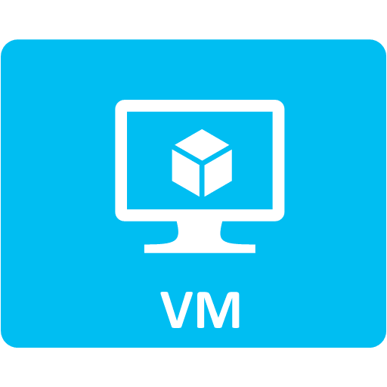

Simple Citrix deployment on GCE
Connect Via go.gcexencloud.net port 443 endpoint on Secure Gateway
User Access
via Internet
Secure Gateway
Delivery Controller
XA Session Host
SQL Server
AD Controller
Web Interface
License Server
XD VDI Host
Single Subnet
Virtual Network

Slide 35
Simple hybrid deployment
AD Controller
Secure Gateway
Delivery Controller
XA Session Host
Site-to-Site VPN
SQL Server
AD Controller
Web Interface
License Server
XD VDI Host
Company resources and Applications Data
Single Subnet
Virtual Network
On-Premise Network

Slide 36


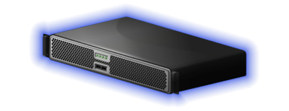
Single Zone
Delivery Controller
SQL Server
AD Controller
Delivery Controller
SQL Server
License Server
XD VDI Host
XD VDI Host
XA Session Host
VPN
Infrastructure
VDI Workers
XA Workers
Virtual Network
Single Zone
Delivery Controller
SQL Server
AD Controller
Site-to-Site VPN
Delivery Controller
SQL Server
License Server
XD VDI Host
XD VDI Host
XA Session Host
VPN
Infrastructure
VDI Workers
XA Workers

Slide 37
Demo
Environment Walkthrough

Slide 38
How do I do this?

Slide 39
Recipe for success
Deploy your Google Cloud Engine (GCE) components
Install and configure the Citrix components
Prepare your golden image
Clone the golden image
Add newly created VMs to Machine Catalog
Setup your Delivery Group

Slide 40
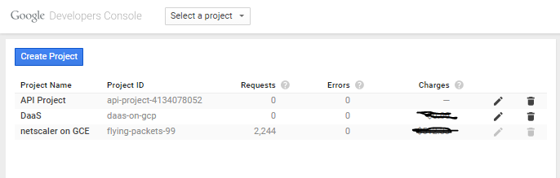
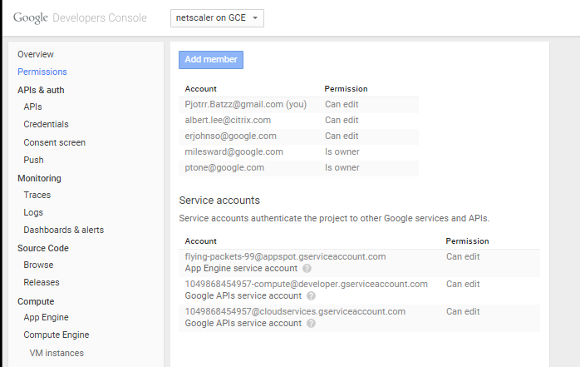
Deploy the GCE infrastructure
Create project
Assign users

Slide 41
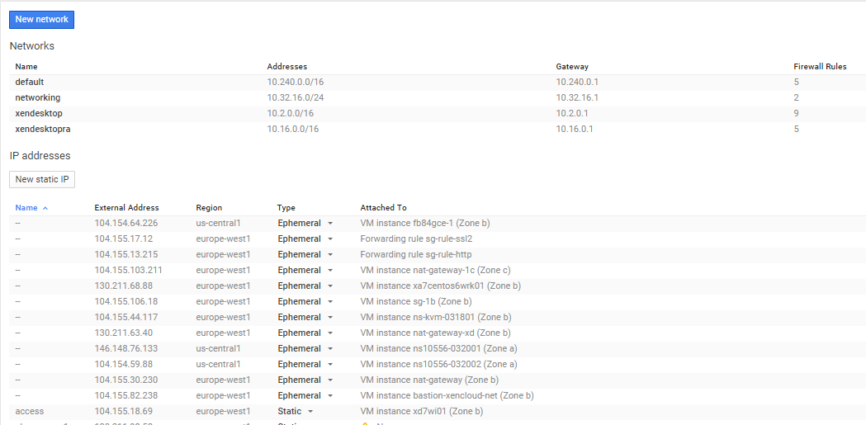
Deploy the GCE infra (continued)
Create virtual network – global virtual network address space
Create static IP
- regional addresses for Secure Gateways

Slide 42
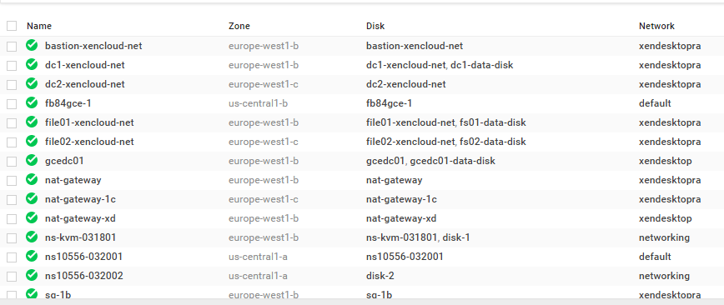
Deploy the GCE infra (continued)
Create VM instances – preferably set to static IPs

Slide 43
Recipe for success
Deploy your GCE components
Install and configure the Citrix components
Prepare your golden image
Clone the golden image
Add newly created VMs to Machine Catalog
Setup your Delivery Group

Slide 44
Install software components
Domain controller : Windows 2012 R2
SQL server : SQL 2012 SP1
Desktop controller : XD7.6 on Windows 2012 R2
XenApp workers : XD7.6 VDA on Windows 2012 R2 / Windows 2008 R2
Server VDI : XD7.6 VDA on Windows 2012 R2 / Windows 2008 R2
Secure gateway : SG 3.3.2 on Windows 2008 R2 SP1
Web interface : WI 5.4.2.59 on Windows 2008 R2 SP1

Slide 45
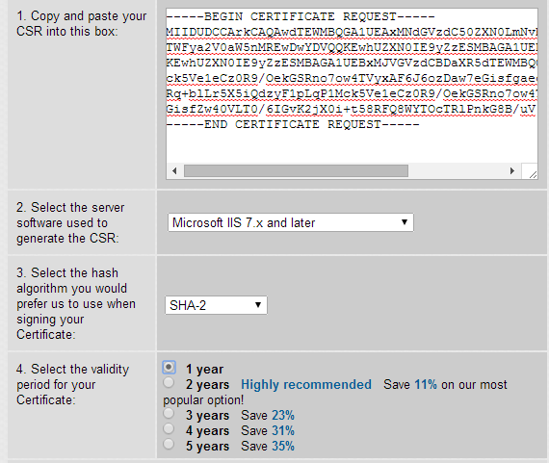
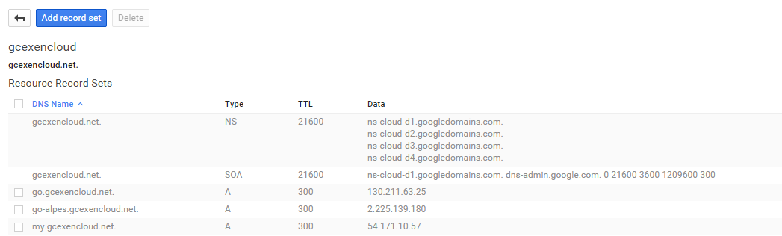
Prep your company's domain name
Issue a cert for your domain name (go.gcexencloud.net)
Create a CNAME

Slide 46
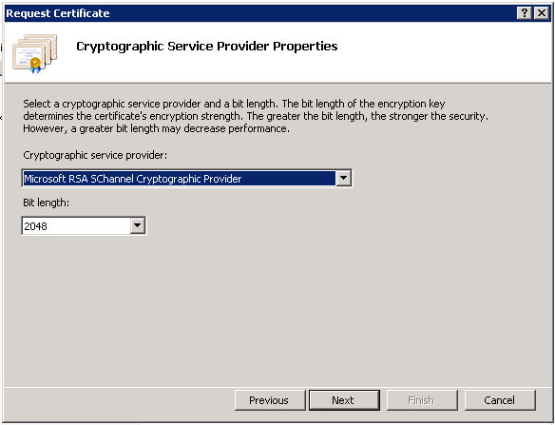
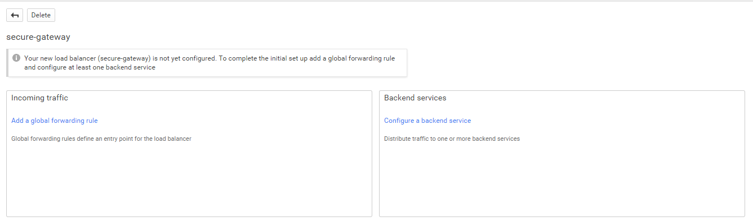
Configuration – Secure gateway
Generate a certificate request
Import issued certificate on Secure Gateway 1
  Make 2048-bit private key exportable
Export cert on secure gateway 1
  Include private key (pfx format)
Import exported Cert on Secure Gateway 2
Delayed automatic start on the service
In GCE, create a HTTPS load balancer set for port 443 and add endpoints for both servers

Slide 47
Citrix NetScaler for GCE – Work in Progress
Too early to tell
Full NetScaler function
    L4-7 traffic management
    Citrix MobileStream
    NetScaler Gateway
    NetScaler Insight
Work in Progress

Slide 48
Single Zone
443
Secure Gateway
StoreFront
Delivery Controller
SQL Server
AD Controller
443
Web Interface
Virtual Network
443
Netscaler
in GCE
Secure Gateway
StoreFront
Delivery Controller
SQL Server
License Server
XD VDI Host
XD VDI Host
XA Session Host
WestCitrix.CloudApp.net
Web Interface
Infrastructure
VDI Workers
XA Workers
Citrix.trafficmanager.net CNAME: citrixonazure.com
Single Zone
443
Secure Gateway
StoreFront
Delivery Controller
SQL Server
AD Controller
443
Web Interface
Virtual Network
Netscaler
in GCE
443
Secure Gateway
StoreFront
Delivery Controller
SQL Server
License Server
XD VDI Host
XD VDI Host
XA Session Host
EastCitrix.CloudApp.net
Web Interface
Infrastructure
VDI Workers
XA Workers

Slide 49
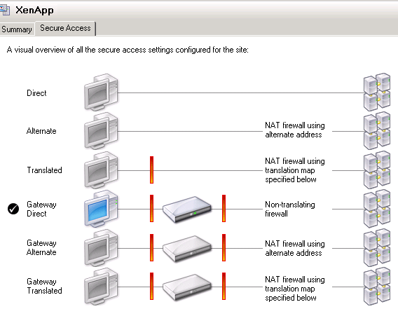
Configuration – Web interface
Authentication method: Explicit, at web interface
Secure access:
  Gateway direct
  FQDN of company domain (gcexencloud.net)
  port 443
  STA is delivery controller

Slide 50
Recipe for success
Deploy your GCE components
Install and configure the Citrix components
Prepare your golden image
Clone the golden image
Add newly created VM instances to Machine Catalog
Setup your Delivery Group

Slide 51
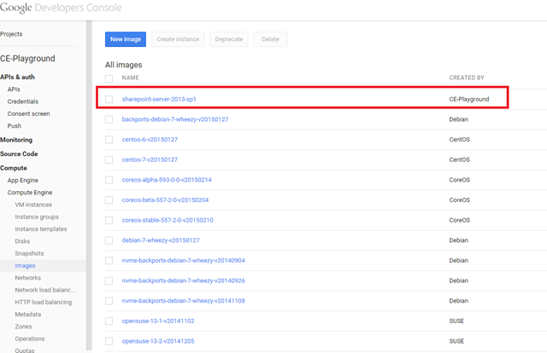
Configuration – XenApp worker server
Create server image
Create a new Windows Server 2012 R2 or Windows Server 2008 R2 VM instance
Prep server golden image with all required software
Install the Citrix virtual delivery agent (VDA) via the user interface
  Sysprep image
  Gcesysprep (don’t run the standard Microsoft Sysprep utility)
  Snapshot the resultant root persistent disk
  Create image in GCE
Create an image using the snapshot as the base

Slide 52
Configuration – Server VDI
Create server image
Create a new Windows Server 2012 R2 or Windows Server 2008 R2 instance
Prep server golden image with all required software
Install Desktop Experience
Install Citrix VDA via command line
XenDesktopVdaSetup.exe /quiet /servervdi
  Create string value ListofDDCs and point it at the appropriate DDCs under
  HKEY_LOCAL_MACHINE\SOFTWARE\Citrix\VirtualDesktopAgent
  Sysprep image
  Gcesysprep (don’t run the standard Microsoft Sysprep utility)
  Snapshot the resultant root persistent disk
  Create image in GCE
Create an image using the snapshot as the base

Slide 53
Recipe for success
Deploy your GCE components
Install and configure the Citrix components
Prepare your golden image
Clone the golden image
Add newly created VM instances to Machine Catalog
Setup your Delivery Group

Slide 54
Clone Golden Image
Use Google Cloud portal to manually create groups of VM Instances using an Instance Template based on the sysprepped image
Alternatively use the gcloud script provided below to create multiple instances based of the golden image

Slide 55
Recipe for success
Deploy your GCE components
Install and configure the Citrix components
Prepare your golden image
Clone the golden image
Add newly created VM Instances to Machine Catalog and setup your Delivery Group

Slide 56
Add VM Instance to machine catalog and create delivery group Using Citrix Studio
Add virtual machine to a new or existing machine catalog
Windows Server OS for XenApp Session hosts
Windows Desktop OS for Server VDI hosts
Select “Deploy using another service or technology”
Create or modify existing delivery group to use new virtual machine

Slide 57
Scale and Economics

Slide 58
Scale testing
Assessment was based on LoginVSI
Validated n1-highcpu-4 thru n1-highcpu-32 (session-based delivery)
Tested the Task-worker, Office-worker and knowledge-worker workloads (loginVSI 4.1)
Validated n1-highstandard-2 thru n1-highstandard-32 (session-based delivery)
Tested the Task-worker, Office-worker and knowledge-worker workloads (loginVSI 4.1)

Slide 59
Machine Types (Shared-Core)
f1-micro
Shared Core
0.6 GB Memory
g1-small
1 Core
1.7 GB Memory
1.38 GCEUs

Slide 60
Machine Types (Standard)
n1-standard-n
Starts from 1 Core
Start from 3.75 GB Memory
n | Virtual CPUs | Memory | GCEUs
1 | 1 | 3.75GB | 2.75
2 | 2 | 7.50GB | 5.50
4 | 4 | 15GB | 11
8 | 8 | 30GB | 22
16 | 16 | 60GB | 44
32^{Beta} | 32 | 120GB | 88

Slide 61
Machine Types (High Memory)
n1-highmem-n
Starts from 2 Core
Start from 13 GB Memory
n | Virtual CPUs | Memory | GCEUs
2 | 2 | 13GB | 5.50
4 | 4 | 26GB | 11
8 | 8 | 52GB | 22
16 | 16 | 104GB | 44
32^{Beta} | 32 | 208GB | 88

Slide 62
Machine Types (High CPU)
n1-highcpu-n
Starts from 2 Core
Start from 13 GB Memory
n | Virtual CPUs | Memory | GCEUs
2 | 2 | 1.80GB | 5.50
4 | 4 | 3.60GB | 11
8 | 8 | 7.20GB | 22
16 | 16 | 14.4GB | 44
32^{Beta} | 32 | 28.2GB | 88

Slide 63
Instance types – Knowledge Workers workload cost/users

Slide 64
Task Worker Workload Users per GCE Instance type
XenApp 7.6 - Windows 2008R2
* This price reflects the total Azure infrastructure costs (no Citrix/Microsoft licensing included)

Slide 65
Knowledge Worker Workload Users per GCE Instance type
XenApp 7.6 - Windows 2008R2
* This price reflects the total Azure infrastructure costs (no Citrix/Microsoft licensing included)

Slide 66
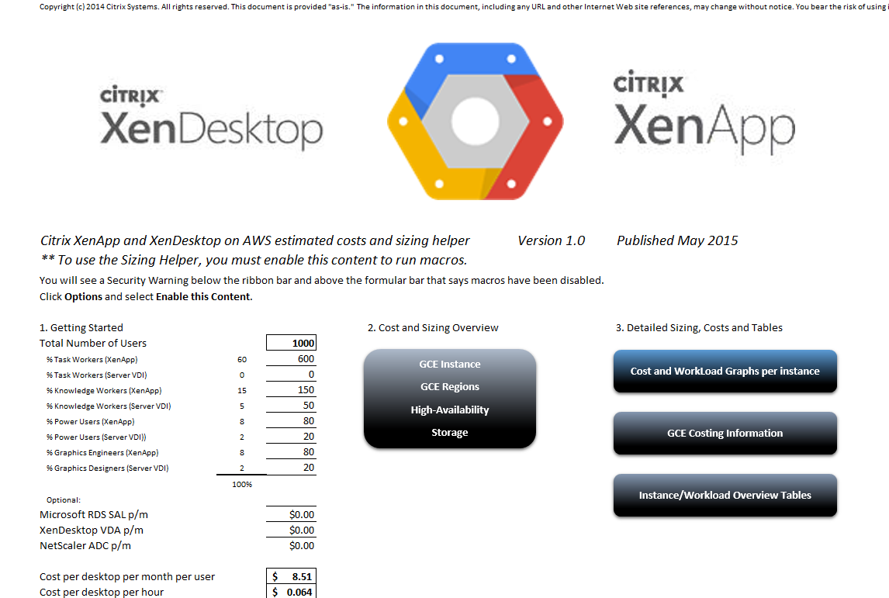
Economics of GCE
Excel spreadsheet
Provided as a tool to estimate costs
Supports two regions and two user profiles
Accounts for computer, network, and storage

Slide 67
Demo
Excel Calculator

Slide 68
Before you leave…
Check http://blogs.citrix.com/author/peterb/ for blog articles on XenApp and XenDesktop on GCE
Conference Surveys are available online at www.citrixsynergy.com starting Thursday, May 14 at 9:00 a.m.
  Those who provide feedback by 6pm, Friday, May 15th will receive:
    $20 Amazon e-gift card
    Name entered in a drawing for a free Trip to Synergy 2016 (5 chances)
Download presentations starting Monday May, 18th from the My Event Planning tool

